Slide 1
Finance Committee
October 7th, 2025
10:00 AM to 12:00 PM
Zoom Meeting

Slide 2
Agenda
Call to order | Don Lutz, Treasurer
Roll Call | Lynda Rable, Director of Finance
Antitrust Reminder | Don Lutz, Treasurer
Approval of Prior Meeting Minutes
Financial Results:
FY June 2025 YTD Financial Results | Mark Schafer, CFO & Lynda Rable, Director of Finance
August 2026 YTD Financial Results CRM Capital Project Funding Review
Adjourn | Don Lutz, Treasurer

Slide 3
Stellar Anti-trust Reminder
Stellar MLS is a for profit corporation whose shareholders and members are engaged in similar businesses and Stellar MLS provides services to such shareholders and members. Whenever such persons engaged in similar businesses gather or when corporations provide services to such similar businesses, there is a risk of antitrust liability or of the appearance of anti-competitive activity. Stellar MLS has adopted strict policies to avoid any such liability or appearances. Any departure from these policies could result in severe civil and criminal penalties to you as individuals, to your company and to your association/board and Stellar MLS.

Slide 4
Stellar June YTD FY2025 Financials

Slide 5
Year End Executive Summary
Stellar finished the year June 2025, in a very strong financial position (What we submitted to our auditors)
  Revenues were ~$2M better than plan
  COGs were ~ $1M better than plan
  Operating costs were $5.6M better than plan
  Operating Income was $9.1M better than plan
  We finished the year with $62.6M on hand with 30 months of net monthly cash burn rate on hand
IOBI finished the year June 2025, In an improving Financial position
  Revenue was $49K better than plan
  Operating expenses were $278K unfavorable to plan
  EBITDA was $16K favorable to plan
  We finished the year with $668K on hand $33K better than we started the year.
UCO finished the year in line with the forecast as a start-up company primarily focused on International activity
  Revenue was favorable to plan, with a modest $2K from a marketing contract.
  Operating Expenses were ~$500K better than plan
  Operating Loss was ~$500K better than planned
  We finished the year with ~$374K on hand.

Slide 6
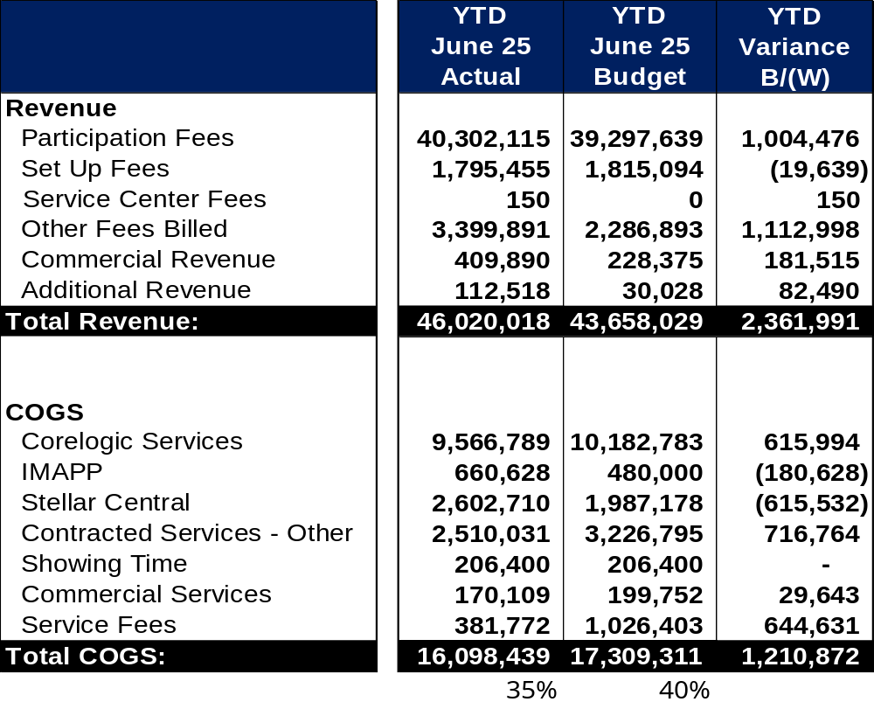
Stellar June YTD FY2025 Financials Actual Vs. Budget (1 Of 2)
Participation Fees: YTD actuals are driven by annual renewals from last year’s annual billing.
Other Fees Billed & Commercial Revenue: Reinstatement fees of ~$500K led the way, followed by Database Accuracy Fines of ~$290K and broker data management fees of ~$200K, which were better than planned.
COGS:
CoreLogic savings are realized due to the slightly aggressive budget rate, coupled with a lower number of new customers.
IMAPP:
Over plan due to the unique customers being stronger than planned.
Stellar Central: Unfavorable due to MoxiWorks termination fees and switch to Centris.
Contracted Services Other:
Favorable due to the implementation delay for New Tools (Paragon Connect, Floorplan, etc.).
Commercial Services “Catalyst”:
Catalyst fees are lower due to more favorable rates than planned.
Service Fees: favorable due to the implementation of credit card processing fees.

Slide 7
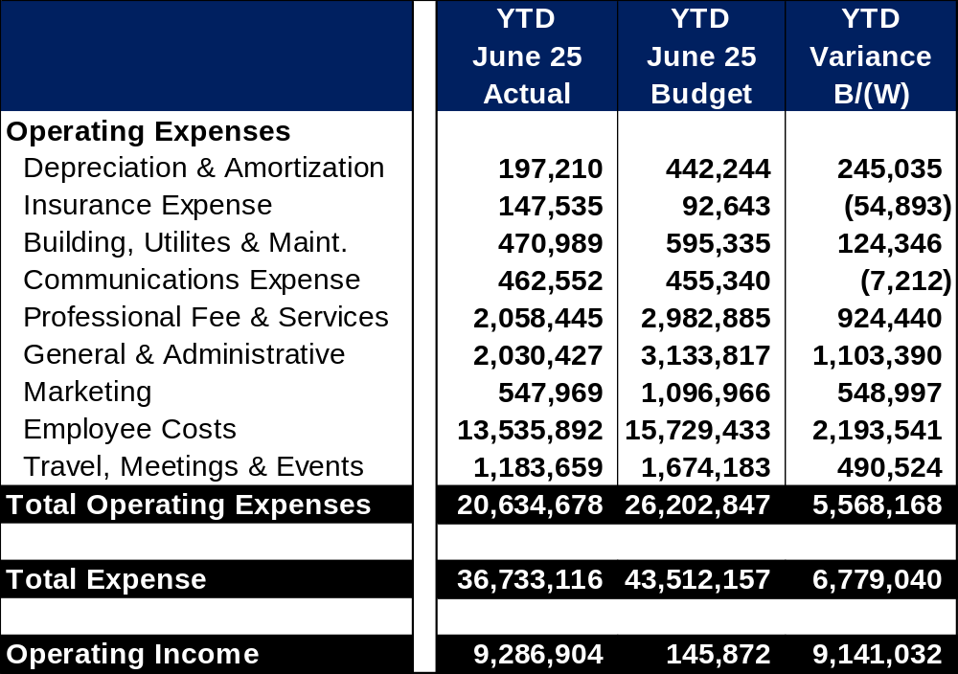
Stellar June YTD FY2025 Financials Actual Vs. Budget (2 Of 2)
Depreciation & Amortization: Is favorable due to delays in the CRM software implementation.
Insurance: Is over budget due to the doubling of our business liability insurance to ~$10M.
Building Utilities and Maintenance: Under plan due to security monitoring installation taking longer than expected.
Professional Fees and Services: Consultant fees for CRM project was not realized due to implementation delay.
General and Administrative: Is primarily favorable due to underspend in SW/HW.
Marketing and TME: Favorable as Marketing and Travel were not utilized as originally planned.
Employee Costs: Primarily driven by open positions for both direct labor and benefits.

Slide 8
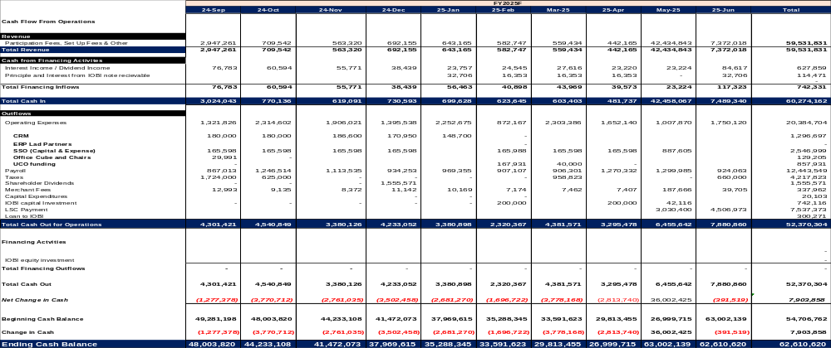
Stellar June YTD FY2025 Cash Flow

Slide 9
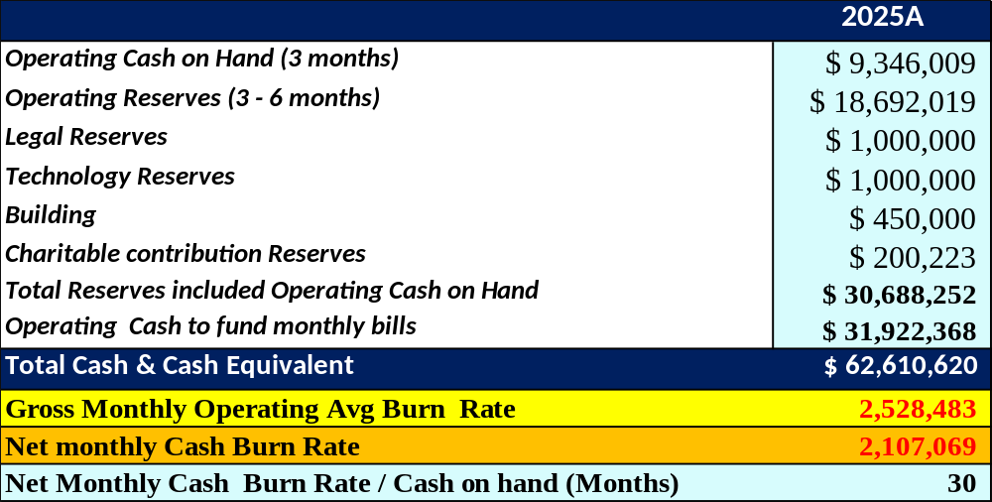
Stellar June FY2025 Reserves
Reserves are forecasted to be fully funded with ~$31.9M of additional cash for monthly operations in FY2026.
Charitable Contribution “Stellar Cares” YTD spend through August results in ~$200K balance. This reserve will fluctuate year to year as new fine revenue is added, and charitable contributions are paid out.
Based on net cash monthly burn rate (monthly revenue – operating expenses) Stellar has ~30 months of projected cash on hand.
Gross Monthly Operating burn - ~$2.5M
Net Monthly Cash burn - ~$2.1M

Slide 10
IOBI June YTD FY2025 Financials

Slide 11
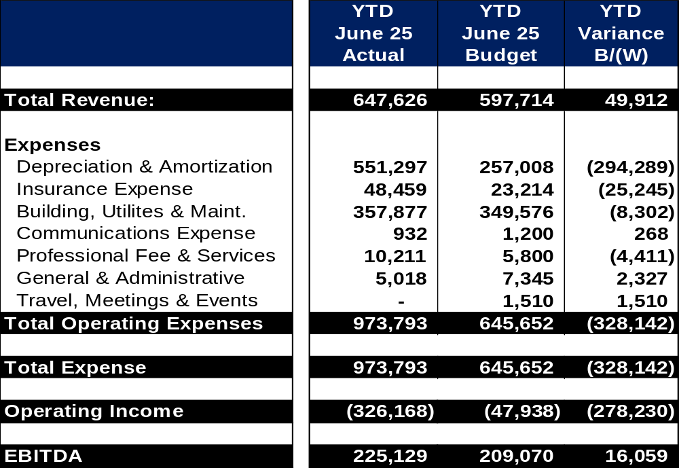
IOBI June YTD FY2025 Financials Actual Vs. Budget
Revenue: Is favorable to budget due to Stellar renting Suite 1000, which was not planned in 2025.
Depreciation and Amortization: Are unfavorable to plan with the 2nd floor renovation, and parking lot repaving being more expensive than planned.
Insurance Expense: Is higher than planned due to rate increases? and property insurance increased sharply over the prior year.
EBITDA: Is slightly better than planned, due to depreciation coming in higher.

Slide 12
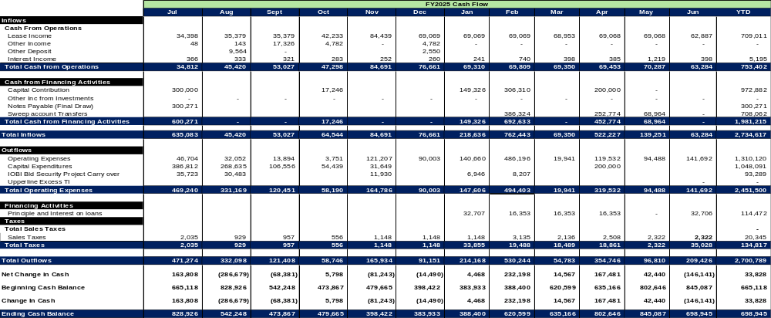
IOBI June YTD FY2025 Cash Flow

Slide 13
UCO June YTD FY2025 Financials

Slide 14
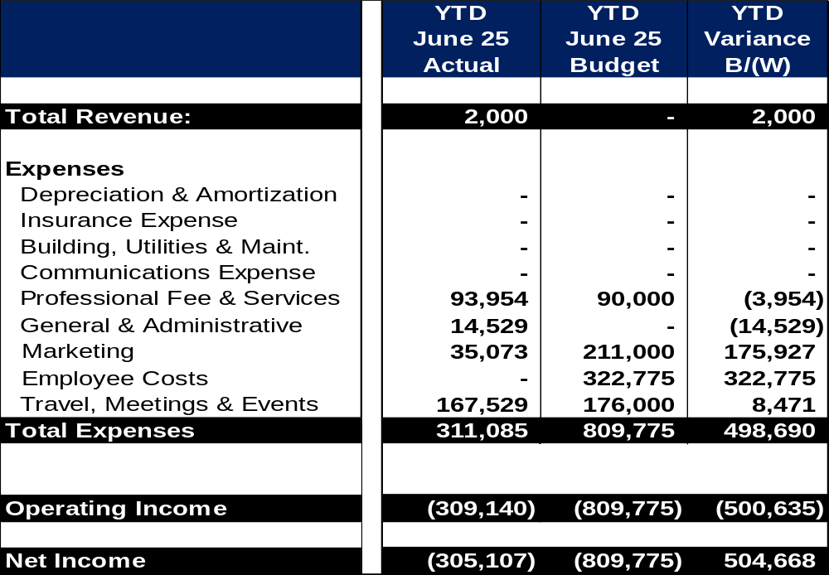
UCO June FY2025 Financials Actual Vs. Budget
Revenue: Favorable due to our marketing consulting agreement with Igluu.
Marketing: Is ~$176K favorable to plan as the team chose to utilize Sponsorships instead of Advertising to create brand recognition.
Employee Costs: Favorable to plan as all UCO dedicated staff are carried under Stellar as part of the start-up investment.
Operating Income: Favorable to plan as all UCO spending was judicious.

Slide 15
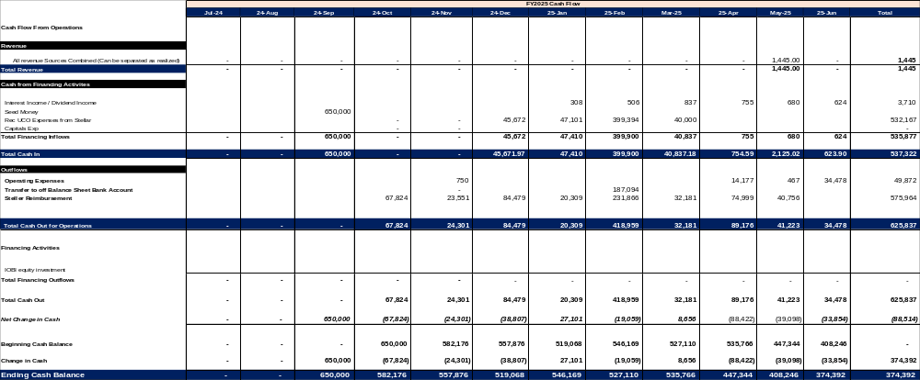
UCO June YTD Cash Flow

Slide 16
Stellar August YTD Results
Financials

Slide 17
August YTD Executive Summary
Stellar first two months of operations are favorable to plan primarily through expense timing
  Revenues were ~$0.6M Lower than plan
  COGs were ~ $0.3M better than plan
  Operating costs were $2.1M better than plan
  Operating Income was $1.9M better than plan
  We finished August with $57.2M on hand, with 25 months of net monthly cash burn rate on hand
IOBI’s first two months of operation are lower than budgeted, as unplanned expenses were realized at the beginning of the year.
  Revenue was ~$500 Lower than plan
  Operating expenses were ~$16K unfavorable to plan
  EBITDA was ~$17K unfavorable to plan
  We finished August with $840K on hand, $28K less than we started the year with.
UCO’s first two months of operation were better than the budget as a start-up company prudently managed expenses primarily focused on International activity
  Revenue was favorable to plan, $1K better than plan
  Operating Expenses were ~$36K better than plan
  Operating Loss was ~$40K better than planned
  We finished August with ~$804K on hand.

Slide 18
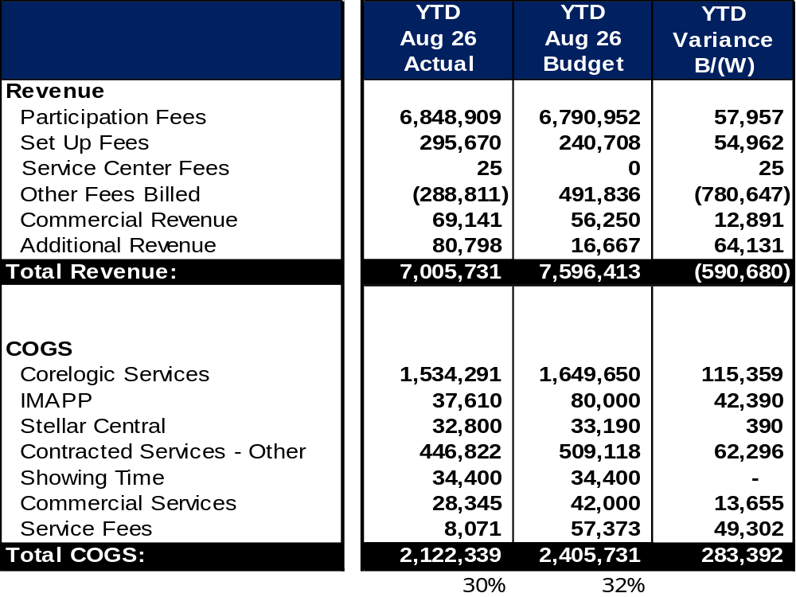
Stellar August YTD FY2026 Financials Actual Vs. Budget (1 Of 2)
Revenue: YTD actuals are driven by annual renewals were down 1.3% from budget. New customers are pacing 7.5% ahead of budget. MRR are pacing at average of 43% over budget.
Other Fees Billed & Commercial Revenue: Overestimated the collection of Reinstatement fees for year-end.
Additional Revenue: Higher than plan due to Skyslope revenue share.
COGS:
CoreLogic savings by lower renewals.
IMAPP:
Is favorable based upon the new contract's terms of new customers definition moving from 2 to 3 visits to count as a customer.
Contracted Services Other:
Favorable due to new product delayed in implantation.
Services Fees:
Credit card merchant fees are favorable due to credit card surcharge.

Slide 19
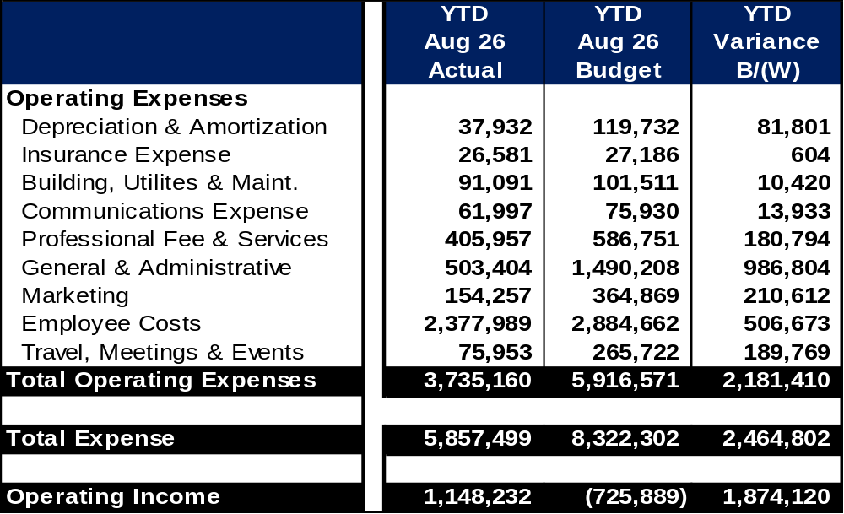
Stellar August YTD FY2026 Financials Actual Vs. Budget (2 Of 2)
Professional Fees, Marketing, G&A:
Professional fees: Favorable due to timing of consultants spend.
G&A is favorable due to timing of software and hardware maintenance
Depreciation & Amortization: Is favorable due to delays in CRM being put into service.
Employee costs: Primarily driven by open positions early in the year and timing for professional development.

Slide 20
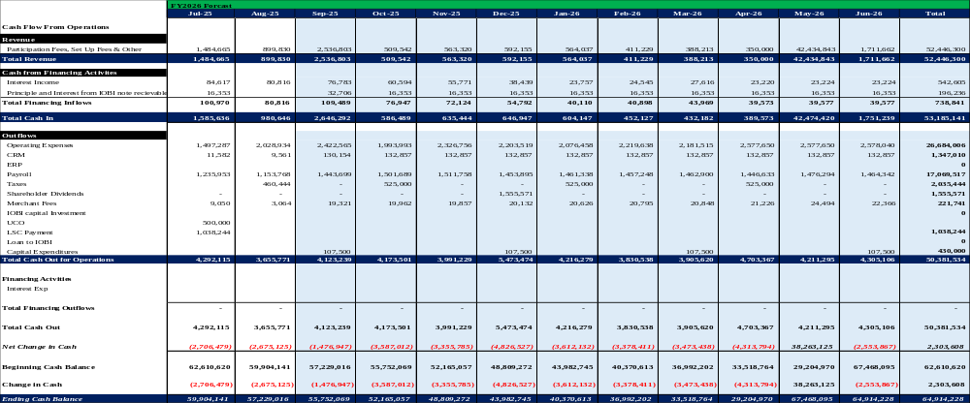
Stellar August YTD FY2026 Forecast Cash Flow

Slide 21
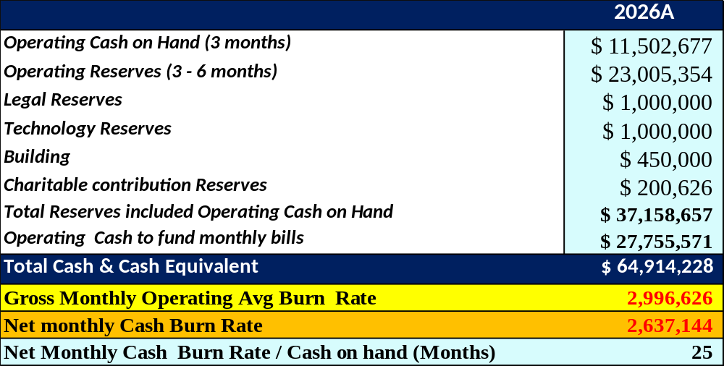
Stellar August YTD FY2026 Reserves
Reserves are forecasted to be fully funded with ~$27.7M of additional cash for monthly operations in FY2026.
Charitable Contribution “Stellar Cares” YTD spend through August results in ~$200K balance. This reserve will fluctuate year to year as new fine revenue is added, and charitable contributions are paid out.
Based on net cash monthly burn rate (monthly revenue – operating expenses) Stellar has ~25 months of projected cash on hand.
Gross Monthly Operating burn - ~$3.0M
Net Monthly Cash burn - ~$2.6M

Slide 22
IOBI August YTD Results
Financials

Slide 23
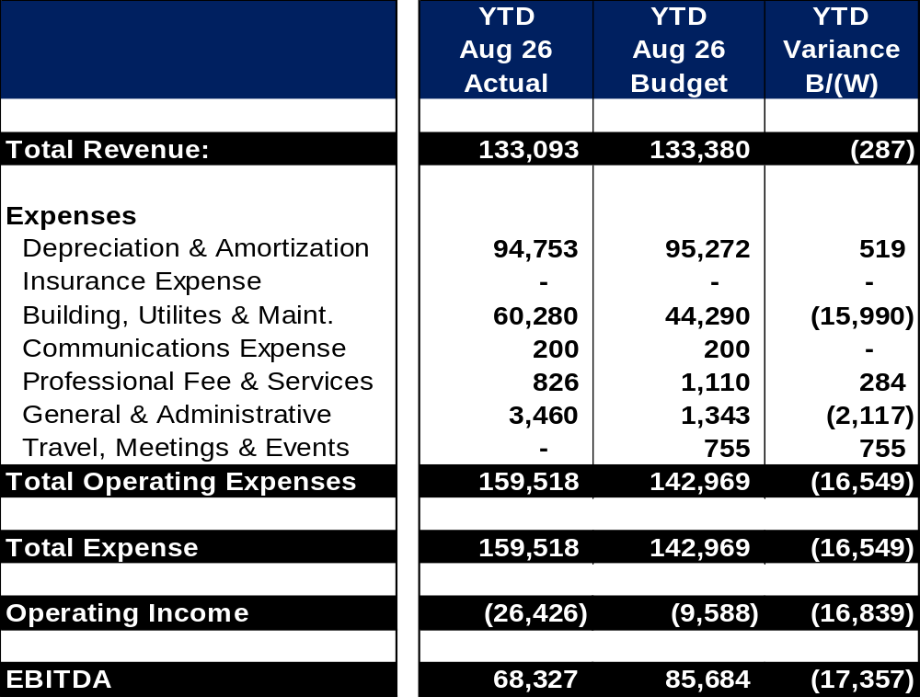
IOBI August YTD FY2026 Financials Actual Vs. Budget
Revenue: Common cost rent recovery is lower than planned, renegotiated in June.
Building, Utilities & Maint.: Currently unfavorable due a $15K backflow replacement.
General & Administrative: Over plan due to a $3K boardroom AV maintenance agreement.
EBITDA: Is under plan due to the backflow replacement and board room AV maintenance agreement.

Slide 24
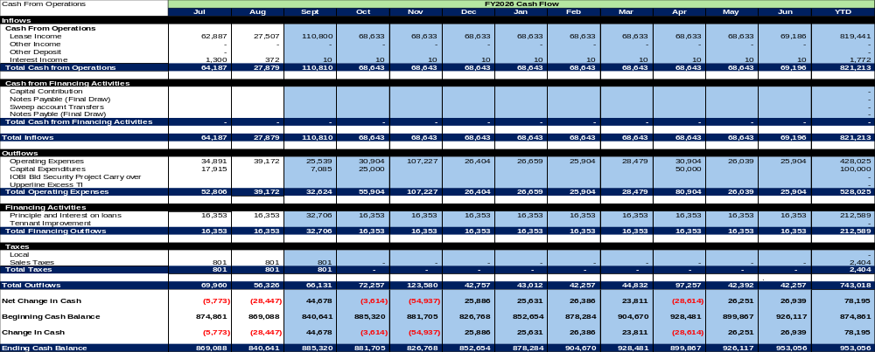
IOBI August YTD FY2026 Forecast Cash Flow

Slide 25
UCO August YTD Results
Financials

Slide 26
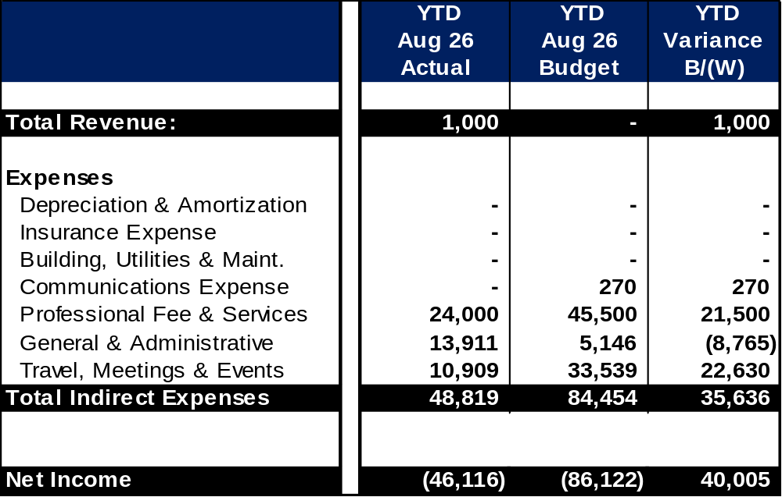
UCO August YTD FY2026 Financials Actual Vs. Budget
Professional Fee & Services: Under plan due to timing of consultant spending.
General & Administrative: Over plan due to reclass of CEPI membership to Dues/Subscriptions from Sponsorships.
Travel, Meetings & Events: Due to timing of travel.

Slide 27
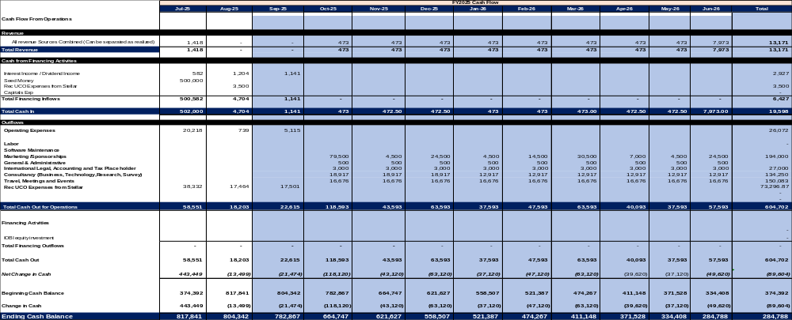
UCO August YTD FY2026 Forecast Cash Flow

Slide 28
MOTION
The Finance Committee recommends to the Board of Directors to approve Stellar MLS, IOBI LLC, UCO LLC 2025 Year End and 2026 August YTD Financial Statements for Consolidated Audit.

Slide 29
CRM Capital Project Funding Review

Slide 30
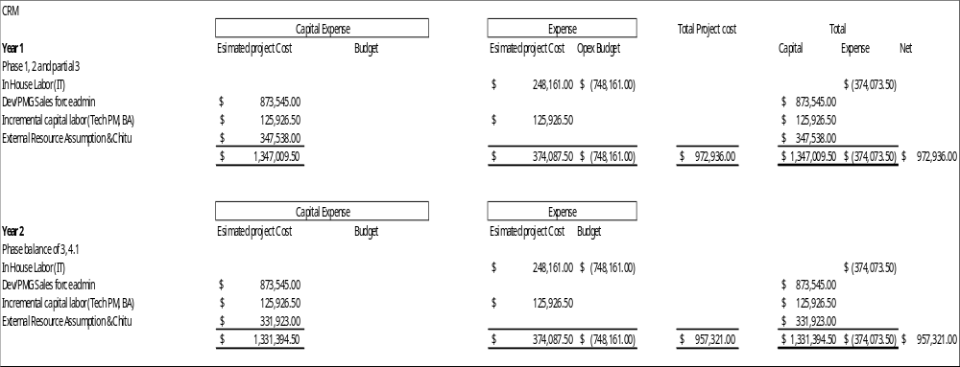
CRM Capital Project Funding Review Part 1

Slide 31
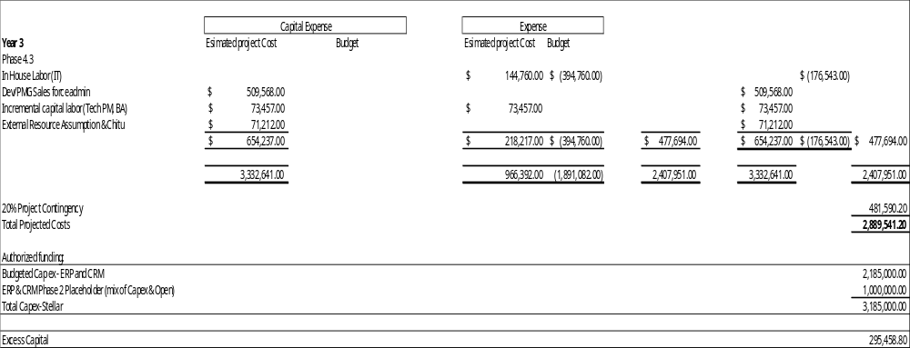
CRM Capital Project Funding Review Part 2

Slide 32
Questions?

Slide 33
The Next Finance Committee Meeting Will Be On February 10, 2026, TBD.
Thank You For Serving On The Finance Committee This Year!

