Slide 1

Finance committee
December Ytd Results &
2027 Budget
February 10, 2026
10:00 AM to 12:00 PM
Zoom Meeting

Slide 2
stellar anti-trust reminder
Stellar MLS is a for profit corporation whose shareholders and members are engaged in similar businesses and Stellar MLS provides services to such shareholders and members. Whenever such persons engaged in similar businesses gather or when corporations provide services to such similar businesses, there is a risk of antitrust liability or of the appearance of anti-competitive activity. Stellar MLS has adopted strict policies to avoid any such liability or appearances. Any departure from these policies could result in severe civil and criminal penalties to you as individuals, to your company and to your association/board and Stellar MLS.

Slide 3
Agenda
Call to order |  | Don Lutz, Treasurer
Roll Call |  | Lynda Rable, Director of Finance
Approval of Prior Meeting Minutes
Financial Results:
FY2026 December Year-to-Date Financial Statements |  | Lynda Rable, Director of Finance
FY2026 Forecast |  | Mark Schafer, Chief Financial Officer
FY2027 Budget |  | Mark Schafer, Chief Financial Officer
Adjourn |  | Don Lutz, Treasurer

Slide 4
Stellar FY2026 Financials
December YTD Results

Slide 5
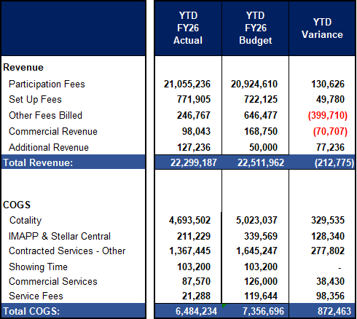
December YTD 2026 stellar financials actual vs. budget (1 of 2)
Participation & Set Up Fees: Better than planned as new & reinstated customers are exceeding planned volumes (Budget Volumes we lower than last year, but actuals are beating budget).
Other Fees: Below budget as our year-end estimate for 2025 was overstated for Reinstatement Fees. Will largely be offset by year-end.
Commercial Revenue: We discovered an error in how the base data was rolling up which overstated commercial revenue. This has been corrected and will result in an unfavorable variance to the year-end budget, in line with our December YTD results.
Additional Revenue: Royalties for Skyslope and Rent Spree.
Cotality: Is favorable to the plan primarily due to rate savings and lower-than-planned customer volume.
IMAPP & Stellar Central: Is primarily timing-related and expected to be closer to budget by year-end.
Contracted Services: under plan due to the delayed implementation of planned new products (New Product placeholder)
Commercial Services – Under plan primarily due to fewer commercial customers than planned.
Service Fees: primarily timing-related and will come back to the budget by year-end.

Slide 6
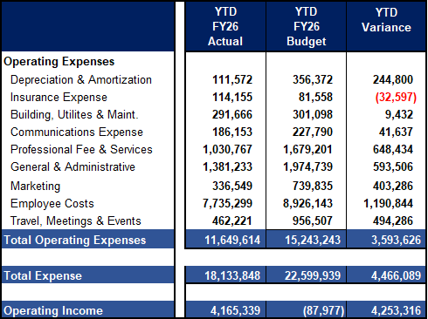
December YTD 2026 stellar financials actual vs. budget (2 of 2)
Employee Costs: Favorable to plan due to open reqs and the associated benefit costs.
Professional Fees: Favorable to plan primarily due to CRM & ERP enhancements, as the CRM project has been delayed. We are moving in a different direction for the ERP project.
General & Administrative: Under plan due to the timing of Hardware and Software project spending.
Marketing: Marketing expenses are being incurred differently than originally planned.
Travel, Meeting, and Events Primarily Timing.
Depreciation: Delayed implementation of the CRM and ERP projects.
Insurance Expense: Increased rates for E&O. Auto insurance paid in full rather than amortized due to new prepaid threshold. .

Slide 7
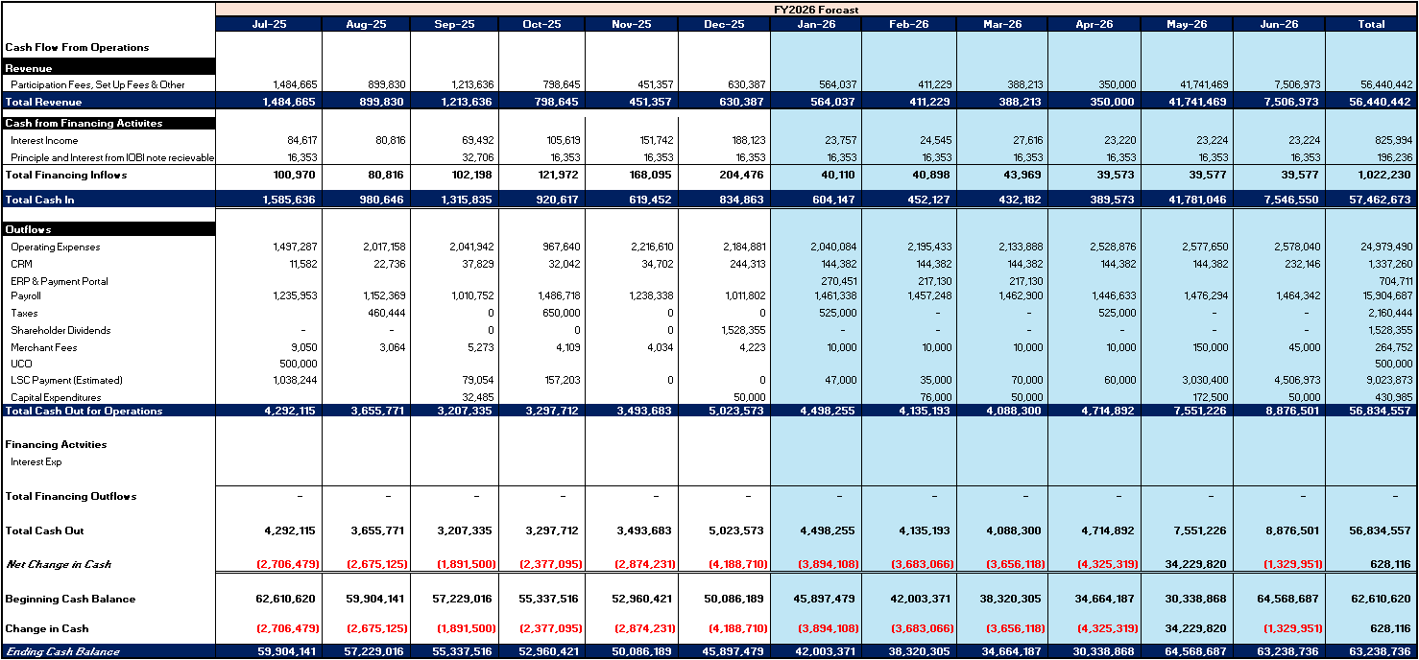
Stellar fy2026 cash flow

Slide 8
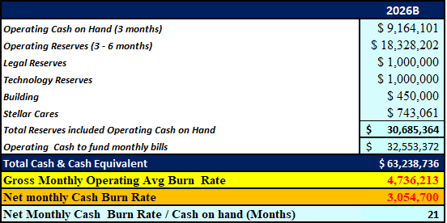
Stellar fy2026 Reserves
Reserves are forecast to be fully funded, with ~$32M in additional cash to fund monthly operations in FY2026.
Stellar Cares December YTD Reserves are $743,000 and fluctuate year to year as new fine revenue is added and charitable contributions are paid out.
Based on net cash monthly burn rate (monthly revenue – operating expenses) Stellar has ~21 months of cash on hand to meet operating costs.
Gross Monthly Operating burn - ~$4.7M
Net Monthly Cash burn - ~$3M

Slide 9
iobi FY2026 financials
December YTD Results

Slide 10
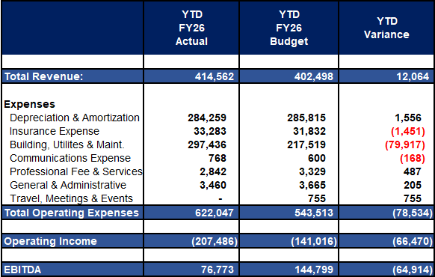
December YTD 2026 IOBI financials actual vs. budget
Building, Utilities & Maint. Unfavorable due to the backflow meter $15K replacement, Fire Marshal citation compliance costs, and irrigation sprinkler repairs.
Insurance: Liability coverage rates increased after budget was completed.
EBITDA: Is under budget primarily due to unplanned expenses for Building, Utilities & Maintenance.

Slide 11
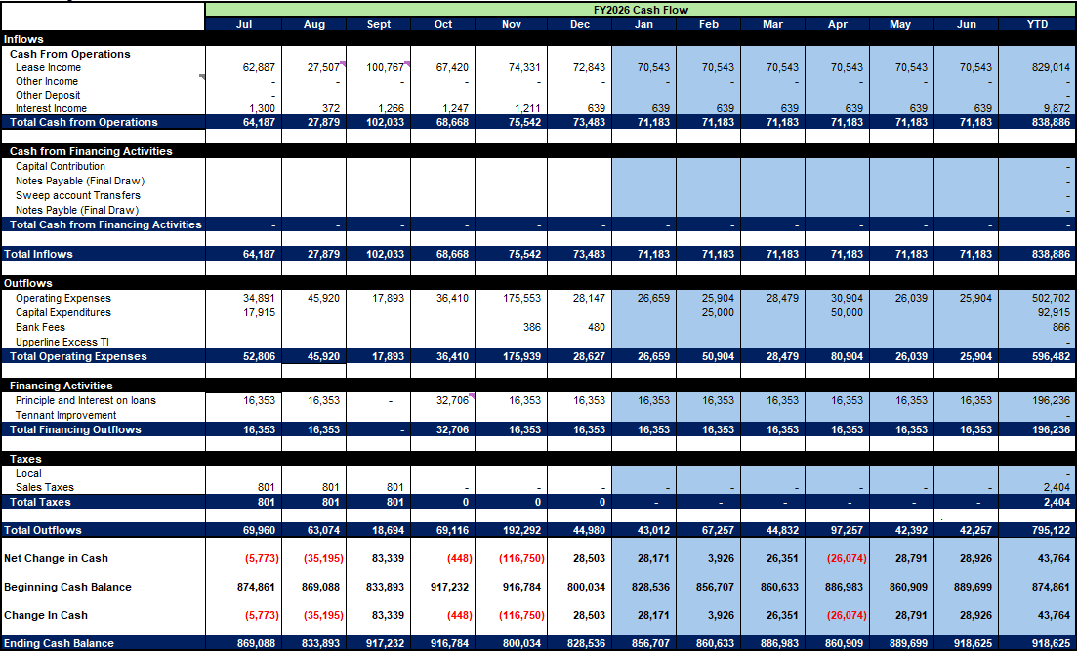
Iobi fy2026 Forecast cash flow

Slide 12
UCO FY2026 Financials
December YTD Results

Slide 13
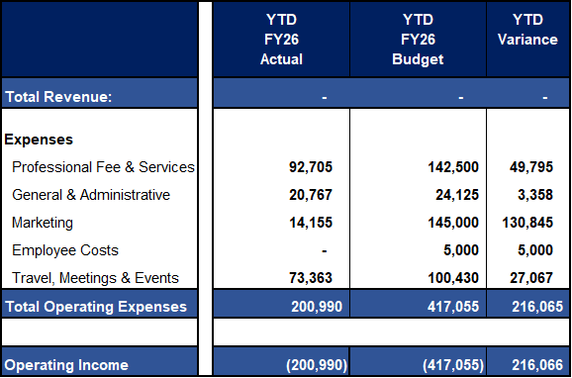
December YTD 2026 UCO financials actual vs. budget
Total Operating Expenses: below budget as the UCO team is judicially spending their resources across the board.
Employee Cost: Due to the slow ramp-up in revenue realization, Stellar will absorb salary costs for the foreseeable future.

Slide 14
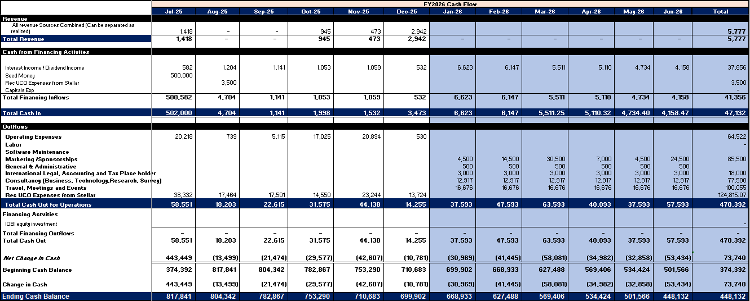
UCO fy2026 Forecast cash flow

Slide 15
Action item
Proposed Action Item:
The Finance Committee recommends to the Board of Directors that the December FY 2026 Stellar MLS, IOBI and UCO Financials be filed for consolidated audit.

Slide 16
Stellar FY2026 Forecast

Slide 17
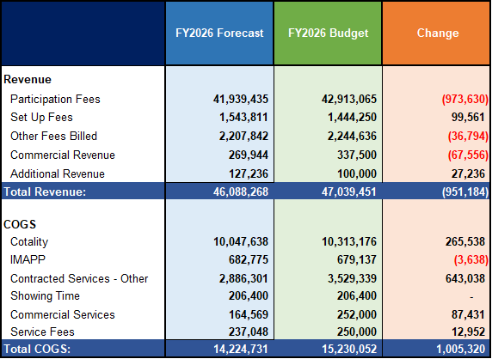
FY2026 Stellar forecast vs. budget- update
Revenue: The renewal revenue shortfall in May of 2025 offsets the positive to budget trends in new and reinstated customers
Other Fees Billed: Is over plan primarily due to the bad estimate for Reinstatement fees in FY2025. These are offset by strong volumes in Fines and Reinstatement fees throughout 2026.
Commercial Revenue: Is below plan due to fewer commercial customers.
COGS:
CoreLogic savings will be realized, as the budget rate is slightly aggressive and the total customers are below the budget.
Contact Services Other:
Favorable due to delayed new product implementations.
Commercial Services “Catalyst”:
Actuals are lower than the budget due to fewer commercial customers

Slide 18
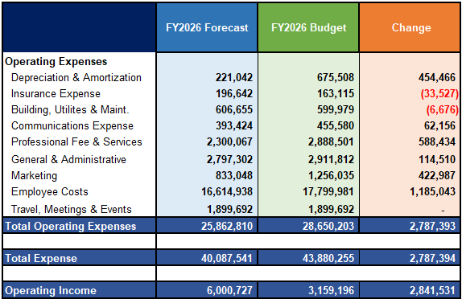
FY2026 Stellar forecast vs. budget- update
Total Employee Costs: Reflecting December YTD Labor Savings.
Depreciation & Amoritization reflect the delayed CRM and ERP projects originally planned to be in service this year.
Professional fees and services: Reflect the enhancement budget for CRM and ERP, not needed as those projects are not operational as originally envisioned.
Marketing: Reflects the December YTD savings for Advertising and Promo Items reflected in the year-end forecast.

Slide 19
Iobi FY2026 Forecast

Slide 20
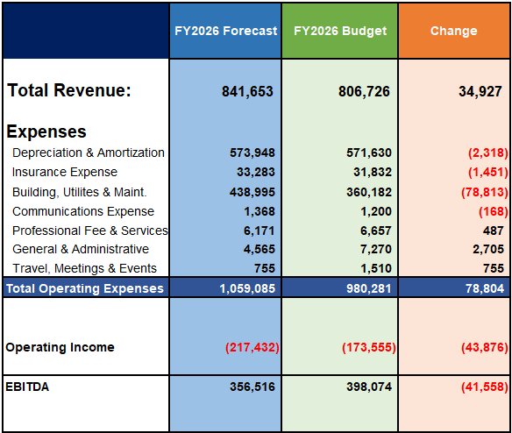
FY2026 IOBI forecast vs. budget- update
Revenue: YTD forecast is better than budget due to common recovery costs higher than planned.
Building, Utilities & Maint.: Due to $15K for backflow valve and Fire Marshall violation compliance cost earlier this year.

Slide 21
UCO FY2026 Forecast

Slide 22
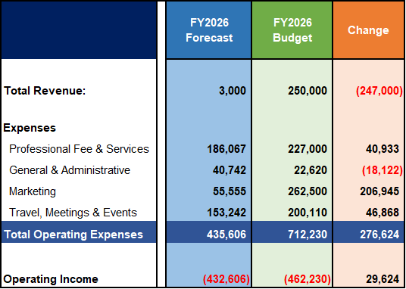
FY2026 UCO forecast vs. budget- update
Revenue: Is unfavorable due to slow ramp up in international markets. Revenue was completely removed in 2026 forecast.
Professional Fees & Services: Forecast based on year-to-date actuals and budgeted amounts for the remainder of the year.
General & Adminstrative: Increase driven by Dues and Subscription expenses exceeding budget.
Marketing: Forecast based on year-to-date actuals and budgeted amounts for the remainder of the year.
Travel, Meetings & Events: Forecast based on year-to-date actuals and budgeted amounts for the remainder of the year.

Slide 23
Stellar FY2027 Budget

Slide 24
Executive Summary 1 of 3
Significant economic uncertainty is looming as we move into 2026, which could adversely impact our spring Annual Billing and New Customer trends for FY2026.
We have largely relied on the 2023 Economic Think Tank recommendations to develop the 2027B with a 90% realization of FY2025 forecasted results.
In November NAR Chief Economist Lawrence Yun is forecasting a 14% nationwide increase in home sales, with new home sales increasing 5% and Median Home prices increasing by 4%.
  He forecasts rates to average around 6% in 2026, down from a roughly 6.7% overall average for this year.
  Young adults still aspire to homeownership, but obstacles remain steep, like high rent, student loan debt and childcare costs. Better financial education about down payment assistance and special loan programs, like FHA,
  Meanwhile, repeat buyers—especially baby boomers—are dominating the housing market, often buying with cash or tapping the substantial home-equity gains they’ve built over years of ownership.
    “It requires some price reduction in order to move the home,” Yun said. “Homes that sit on the market for long ... will need to reduce the price to attract buyers.”
  So, while 2025 was mostly a stagnant year for housing, Yun believes the conditions for a meaningful recovery are falling into place for 2026.
While NAR is forecasting an uptick, others are calling for a sluggish housing market for 2026. (December Headlines from CNBC)
    Apartment rents drop further, with vacancies at a record high.
      The national median rent for apartments fell 1% in November from October, and now stands at $1,367, according to Apartment List.
      The national multifamily vacancy rate was 7.2% in November, a record high.
      The historic surge in multifamily construction over the past few years is now pulling back, but a good supply of new units is still coming online at a time of much weaker demand.
  Home prices go negative for the first time in over 2 years — and may stay that way for a while.
    Prices nationally are down less than 1%, but certain markets are seeing more significant drops: Prices in Austin, Texas, are down 10% from last year; in Denver, they’re down 5%, according to Parcl Labs. Tampa, Florida, and Houston both saw prices fall 4%, and Atlanta and Phoenix saw price decreases of 3%.
    The average contract interest rate for 30-year fixed-rate mortgages with conforming loan balances of $806,500 or less increased to 6.38% from 6.33%. ( latest is 6.18% vs last week 6.10%) 1.26.2026.
Stellar Specific Stats for December are as follows;
  New Listings are -10% from last year, and down 13% from last month.
  Pending listings are up 3% from Last year, but down 10% from last month
  Solds are up 5% from last year and up 27% from last month.
  Median Sales Price is down 2% from last year and up 1% from last month.

Slide 25
Executive Summary 2 of 3
Despite this uncertainty in the marketplace, Stellar will continue to provide excellent customer service and tools for our customers.
  We are planning our headcount to be slightly higher than 2026 forecast, with total staffing increased to 138 from 137.
  However, Senior Staff would like to add 1 additional headcount. If annual billing and ongoing results exceed our expectations, we would add headcount to the Marketing, Customer Support, and Compliance teams.
    Data Engineer: Backup role for the Manager of Data Solutions & IT Cyber Security
    UCO Relationship Coordinator – As activity has picked up, additional support is required to effectively coordinate this demand.
    Marketing UX/UI Coordinator: Backup role to the UX/UI position.
    Customer Support and Administration: Staff where activity metrics call for increased headcount to meet customer demand.
Stellar will continue to invest in new technologies and processes to enhance the customer experience, providing the best data and analysis in the market to help our customers excel.
  Black Knight/ICE: Broker Choice cutting-edge front-end MLS to determine if customers want to retain Matrix or switch by Q3 of FY2026-2027.
  Broker Public Portal to provide Public portal access for agents’ customers to shop and stay in contact with their lead by Q1 of FY2026-2027.
  Lundy Navigator/NORA – supporting external chatbot and AI Voice Search feature by Q2 of FY2026-2027.
  Universal Add/Edit module that will be the gateway to offer a broader mix of MLS tools for agents and brokers by fall of FY2026-2027.
  Showing Time + Essentials: Tools that enable agents to analyze market stats and create branded market activity reports for clients by the fall of FY2026-2027
  Crexi: This service provides a solution for commercial customers to effectively market, analyze, and trade commercial property. Catalyst will not be renewed by Q1 of FY2026-2027.
  Roomvo and Collabra are new tools that will help agents support customers’ needs to visualize what could be and provide advertising content for marketing properties on social media in Q1 FY2026-2027.
  Real Reports to provide current market conditions for Agents and Brokers, FY2026-2027

Slide 26
Executive Summary 3 of 3
The Merit pool will increase by 4% to maintain parity with current job holders at 4% vs job hoppers at 6.
  The January NFIB Survey of small businesses indicates that they are planning 5% increases for 2026.
Benefits are planned to grow by 20% due to the expectation of skyrocketing healthcare costs next year. Additionally, we are investing in reducing employee contributions for dental and vision care to align with industry averages across all coverage tiers.
New customers added to Stellar's roster are forecast to decline by 15% against prior year in line with the decline in candidates passing state real estate exams compared to the 2024 pace.
New customer trends are forecast for FY2026, higher than the budget by 734, resulting in 9,530 customers. Our 2027 budget is planned at 90% of the 2026 forecast, achieving 8,576 customers for the year.
However, returning veterans are outpacing all previous records of reinstated customers and are forecasted in 2026 to reach 2,139, higher than last year’s peak of 1,770 customers. In line with our overall assumptions, we are budgeting 1,925 customers for FY 2027.
The following scenarios illustrate projected revenue performance (profitability or loss) under various MLS fee increase assumptions.
  Management is proposing a $25 increase in MLS fees for residential customers, raising the fee to $550, and a $25 increase for non-licensed assistants, raising the fee to $150. Under this scenario, total revenues are projected to be approximately $46.2 million, resulting in an estimated operating loss of ~$227,868. Cash on hand is budgeted to decline by ~ $6.4 million to $56.9 million by June 30, 2027.
  Alternative scenarios assuming MLS fee increases of $35 and $50 were also evaluated. Under the $35 increase scenario (MLS fee of $560), the projected operating profit is ~$559,000. Under the $50 increase scenario (MLS fee of $575), the projected operating profit is ~$1.7 million.

Slide 27
FY2027 (Spring of 2026) annual billing Projections
Consistent with last year’s annual billing forecast, we are applying a blended approach using total theoretical billings multiplied by actual realization
Date | MRA | MRN | MRR | Total | Billed | Blled Actual vs Billed Theoretical | 3 Year Average | Paid | Paid as % of Actual Billed
6.30.2020 | 52,259 | 11,224 | 859 | 64,342 | 61,805 | -3.9% |  | 56,849 | 92%
6.30.2021 | 56,849 | 15,695 | 953 | 73,497 | 68,647 | -6.6% |  | 63,620 | 93%
6.30.2022 | 63,620 | 15,415 | 767 | 79,802 | 74,327 | -6.9% | -5.8% | 68,885 | 93%
6.30.2023 | 68,885 | 13,934 | 538 | 83,357 | 81,764 | -1.9% | -5.1% | 75,707 | 93%
6.30.2024A | 74,457 | 13,287 | 1,209 | 88,953 | 85,394 | -4.0% | -4.3% | 77,355 | 91%
6.30.2025A | 77,355 | 9,191 | 1,860 | 88,406 | 81,486 | -7.8% | -4.6% | 73,721 | 90%
6.30.2026F | 73,721 | 9,529 | 2,139 | 85,390 | 76,851 | -10% |  | 70,100 | 90%

Slide 28
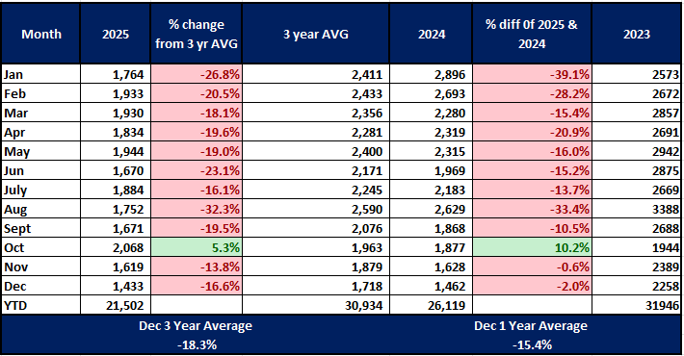
Candidates Passing Real estate Exams continue to decline
Candidates passing Exams are the feedstock for future customers.
Through December 2025, graduates are below the prior year’s trend by 16%.
Stellar conservatively projects that new customers will be ~90% of our 2026F.
Hurricane in Sept & Oct FY2022
The 3-year average is made up of 2025, 2024 & 2023.

Slide 29
FY2027B Customer numbers
New Members |  | Jun | Jul | Aug | Sept | Oct | Nov | Dec | Jan | Feb | Mar | Apr | May | Total
2020A |  | 914 | 894 | 1,056 | 994 | 949 | 888 | 1,020 | 827 | 604 | 1,096 | 1,002 | 980 | 11,224
2021A |  | 1,064 | 1,176 | 1,343 | 1,496 | 1,307 | 1094 | 878 | 1,558 | 1,475 | 1,726 | 1,280 | 1,298 | 15,695
2022A |  | 1,390 | 1,281 | 1,388 | 1,277 | 1,294 | 1,077 | 870 | 1,411 | 1,444 | 1,400 | 925 | 1,658 | 15,415
2023A |  | 925 | 1,658 | 527 | 1,717 | 1,849 | 1,345 | 794 | 1,093 | 786 | 1,096 | 1,023 | 1,121 | 13,934
2024A |  | 1,279 | 1,185 | 1,241 | 1,097 | 1,174 | 865 | 658 | 1,333 | 1,193 | 1,181 | 1,101 | 980 | 13,287
2025A |  | 904 | 935 | 1,033 | 995 | 821 | 711 | 573 | 1,189 | 969 | 1,061 | 1,013 | 835 | 11,039
2026F |  | 970 | 875 | 866 | 799 | 794 | 595 | 470 | 976 | 796 | 871 | 832 | 686 | 9,529
2026 B |  | 800 | 800 | 800 | 800 | 709 | 600 | 500 | 886 | 800 | 800 | 700 | 600 | 8,795
2027 B |  | 873 | 788 | 779 | 719 | 715 | 536 | 423 | 879 | 716 | 784 | 749 | 617 | 8,576
2027B is calculated at ~90% of 26 Forecast .
Reinstates |  | Jun | July | Aug | Sept | Oct | Nov | Dec | Jan | Feb | March | April | May | Total
2020A |  | 87 | 103 | 136 | 98 | 98 | 59 | 45 | 69 | 68 | 35 | 13 | 48 | 859
2121A |  | 3 | 93 | 154 | 150 | 142 | 77 | 58 | 105 | 63 | 57 | 24 | 27 | 953
2022A |  | 66 | 113 | 102 | 75 | 104 | 70 | 50 | 54 | 62 | 62 | 1 | 8 | 767
2023A |  | 4 | 45 | 161 | 135 | 34 | 33 | 26 | 44 | 29 | 19 | 1 | 7 | 538
2024B |  | 4 | 41 | 144 | 121 | 31 | 30 | 23 | 40 | 26 | 17 | 1 | 7 | 485
2024A |  | 98 | 133 | 145 | 142 | 102 | 99 | 57 | 126 | 96 | 90 | 64 | 57 | 1209
2025A |  | 182 | 346 | 243 | 223 | 163 | 131 | 109 | 195 | 124 | 144 | 135 | 91 | 2086
2026F |  | 213 | 306 | 254 | 243 | 174 | 116 | 114 | 204 | 129 | 150 | 141 | 95 | 2139
2026B |  | 125 | 217 | 175 | 175 | 125 | 125 | 125 | 126 | 96 | 90 | 84 | 78 | 1541
2027B |  | 192 | 275 | 229 | 219 | 157 | 104 | 102 | 183 | 117 | 135 | 127 | 86 | 1925

Slide 30
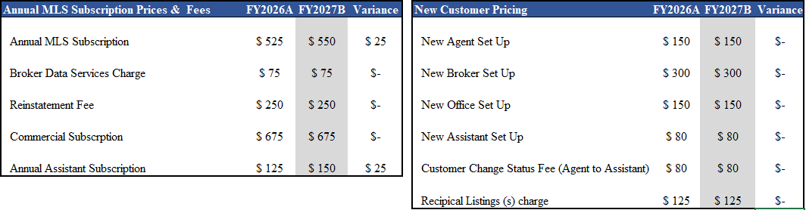
Stellar MLS 2026-2027 fees
Stellar MLS prices are scheduled to be increased as outlined below.

Slide 31
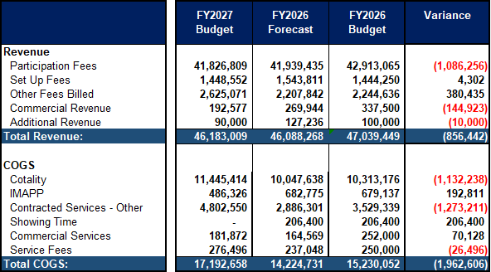
Stellar FY2027 budget (1 of 2)
Participation fees:
Increased MLS annual fee. ($525 -$550)
Increased unlicensed Assistants from $125 to $150
Offset by lower customer volumes.
Set-up Fees / Other Fees Billed: Primarily driven by Fines, followed by Reinstatement fees.
Commercial Revenue: Anticipated 286 customer renewals plus 11 new customers
Cotality Services: This increase is a direct result of:
Increased Subscription rates YoY. (in Negotiations)
Offset by declining new customers.
Contracted Services-Other: Increased costs for new products, Lundy AI, Universal Add/Edit, ICE MLS tool, and annualization of Broker Public Portal.

Slide 32
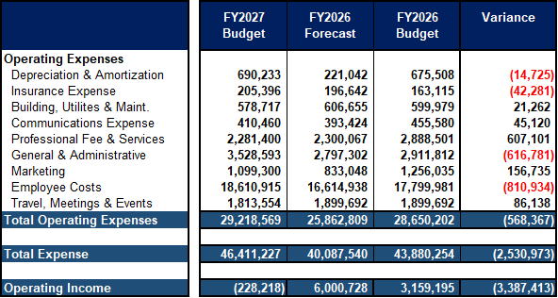
Stellar FY2027 budget (2 of 2)
Professional Fee & Services: Primarily due to reductions in CRM enhancements, reduced expansion placeholder, and reduction of Speakers and Consultants. See page 38 for more details.
General & Administration: Primarily driven by Hardware and Software Services. Please see page 39 for more details.
Marketing: Reduced advertising and Promo costs in line with previous year’s actuals.
Employee Cost: Increase driven by a 4% merit pool, a 20% increase in health care costs, additional headcount, and the reclassification of Temporary and Recruiting services to Employee Costs.
Travel, Meetings & Events: Following a review of the travel budget certain meetings were discontinued.

Slide 33
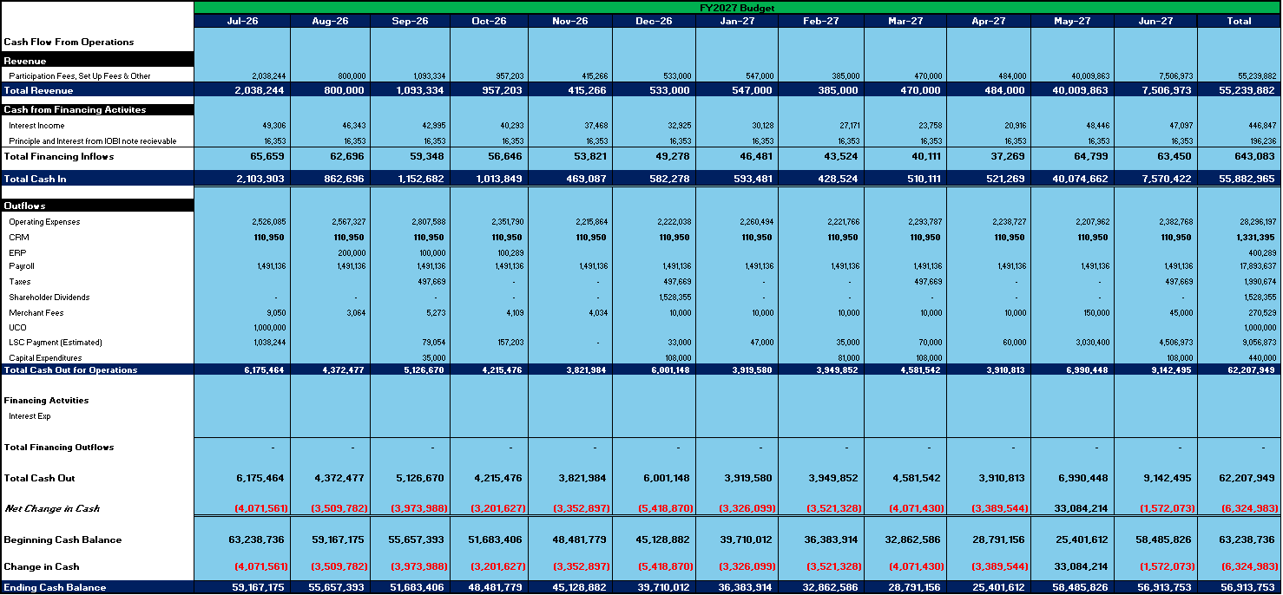
stellar FY2027 cash flow Budget

Slide 34
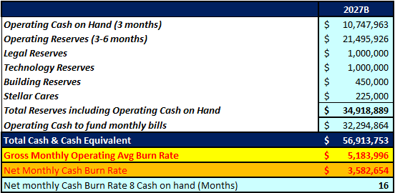
FY2027 Budgeted Reserves
Gross Monthly Operating burn - ~$5.1M
Net Monthly Cash burn - ~$3.5M

Slide 35
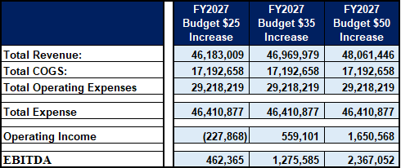
REVENUE Scenarios

Slide 36
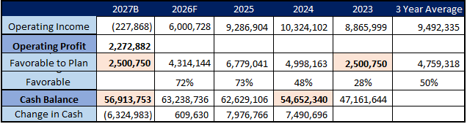
Profitability Projection Fy2027
While we are budgeting for a ~$228,000 operating loss, we are likely to achieve ~$2,500,000 in cost savings across operating costs, generating potential Operating income of ~$2,300,000.

Slide 37
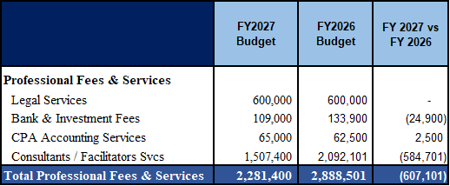
Breakdown of Professional Services

Slide 38
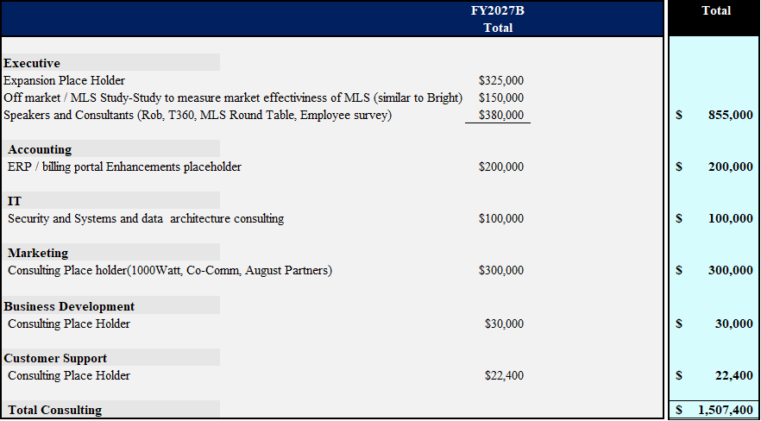
Consultants & facilitators budget

Slide 39
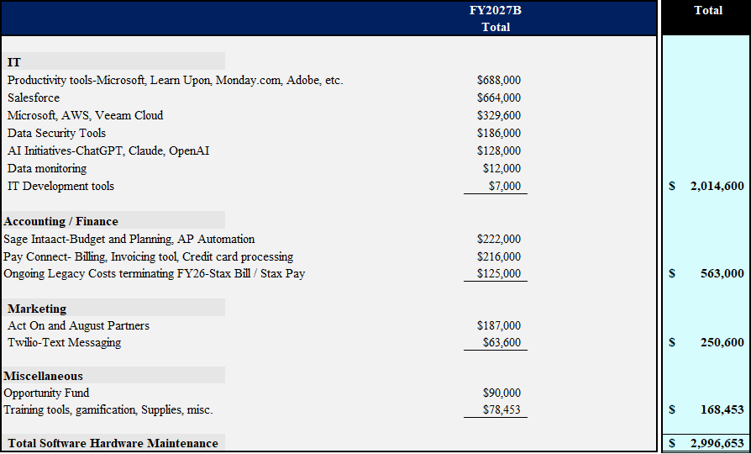
Software Hardware Maintenance budget
This illustrates 85% of total G&A Expenses.

Slide 40
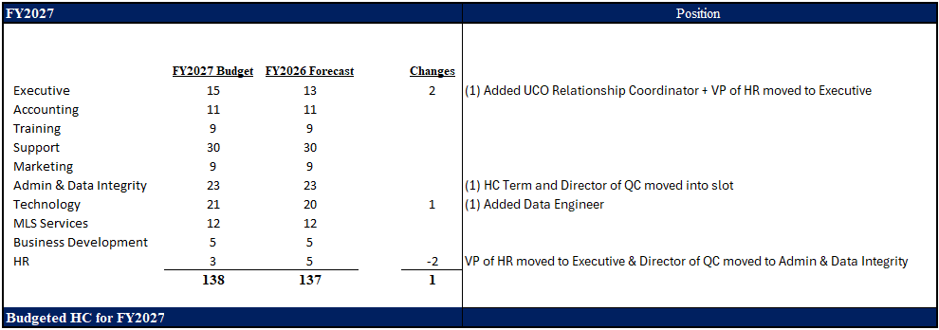
2027B Headcount by Department

Slide 41
Positions pending financial status
UX/UI Coordinator – funded for ½ a year - Increased vendor cross marketing cooperation
Support Center Technician-due to current zoom metrics over FY25 Admin & Data Integrity Specialist -due to current zoom metrics over FY25
The proposed total for these roles including benefits ~$226,832

Slide 42
FY2027 CAPEX BUDGET
STELLAR
CRM Project Phase 2 (Mix of Capex & Opex) | $1,331,395
ERP Implementation (Mix of Capex & Opex) | $400,289
Additional Laptops | $100,000
Replacement Cars (4 new) | $100,000
 | $1,931,684
Stellar Additional: | $240,000
Opportunity Fund
Total Capex -Stellar |  |  | $2,171,684

Slide 43
IOBI FY2027 Budget

Slide 44
Executive Summary
2027 Budget Overview:
The building is completely leased for 2027.
Revenue Streams:
  Suite 2000: Stellar MLS
  Suite 1000: Stellar MLS
  Suite 1100: Upperline
    Base Rent
    Common Cost Recovery
Financial Highlights:
Revenue: Expected to increase to ~$828,000, representing an increase of ~$21k over the 2026 budget reflecting normal lease increases annually.
Operating Expenses: Projected to rise to ~$1,025,000 an increase of ~45,000, 4.5% compared to the 2026B. The increase is primarily driven by Electricity, Property taxes, and Property insurance.
Operating Loss: Estimated at ~$197,000, an increase of ~24,000 over the 2026B.
EBITDA (Cash Flow): Projected to be ~$379,000, less than last year, with a decline of ~$19K, worse than 2026 budget, primarily driven by increased operating costs outlined previously.
  Key Milestone:
  IOBI is self-funding the $190,000 CAPEX, primarily to support generator and elevator replacements while adding modestly to cash on hand.
  Future Considerations:
  The Stellar Lease must be renegotiated by August 2027. We will most likely model it after the Upperline Lease.

Slide 45
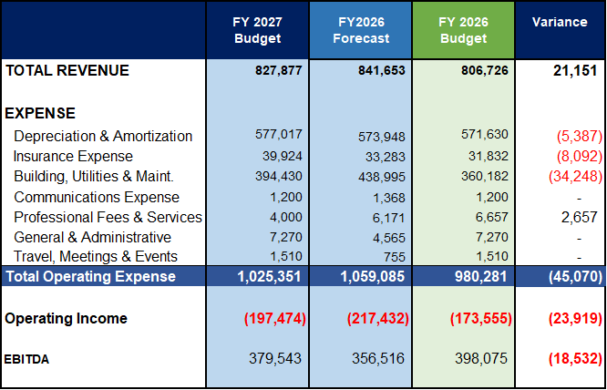
IOBI FY2027 budget
Building Utilities and Maintenance: increased Building repairs in line with 2026F, anticipated increased property taxes and utilities.
Depreciation& Amortization: Is unfavorable due to timing of project completion and assets going into service.
Insurance Expense: Is unfavorable due to rate increases.
Professional Fees & Services: is favorable due to reduced bank fees

Slide 46
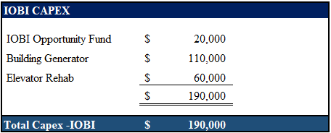
FY2027 CAPEX BUDGET

Slide 47
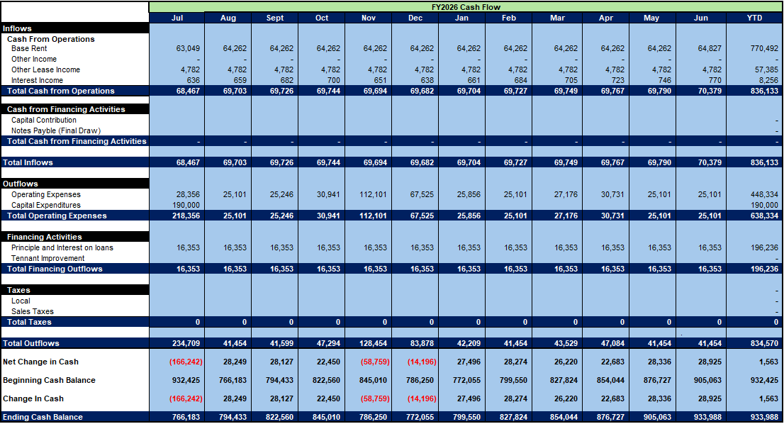
IOBI FY2027 cash flow budget

Slide 48
UCO FY2027
Budget

Slide 49
Executive Summary
UCO consists of outreach efforts both internationally and domestically.
International Efforts:
FY2026 Success
  UCO expanded from 17 to 31 active markets across 5 continents, supported 15+ global industry events, and secured its first paying global client—without scaling fixed costs
  UCO is now positioned as a trusted global authority in MLS modernization, with multiple markets nearing implementation readiness
  FY2026 validates UCO’s ability to operate with financial discipline while building global influence
FY2027 Goals and Objectives
  FY2027 is a controlled transition year focused on converting influence into diversified revenue—without sacrificing fiscal control.
  UCO will convert advanced-stage global engagements into recurring consulting and implementation revenue
  Most team or program expansion will be staged and tied directly to contracted or near-term revenue opportunities.

Slide 50
Executive Summary
Domestic Efforts:
  Target audiences include U.S.-based associations exploring options to regionalize or consolidate MLS operations.
  Initial services will involve consulting on MLS consolidation, with potential retail service agreements in the future.
  Seeking opportunities for reciprocal access agreements (5 in FY2026) with MLSs in markets experiencing migration to and from Florida.
  Efforts in this phase will leverage existing staff and resources, with a modest investment in marketing and promotion.
2026 Budget and Funding:
The 2026 Budget focuses on the International UCO effort. As noted in previous years, all labor is allocated within Stellar to assist in funding requirements as UCO ramps up efforts to monetize international markets. Domestic UCO costs will continue to be borne in the Stellar MLS budget
  AS UCO attempts to monetize its international efforts, funding costs are increasing, requiring $1M as seed money for FY2027.

Slide 51
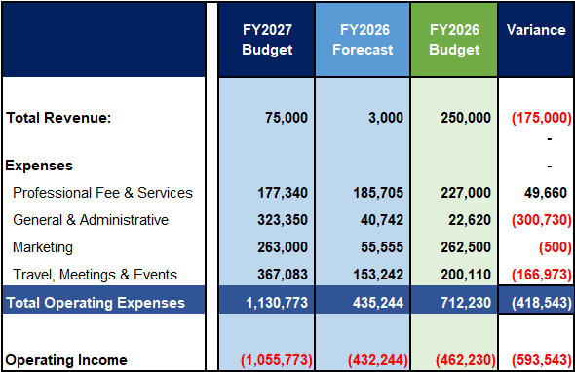
UCO International FY2027 budget
Revenue: Anticipated NAR India revenue.
Professional Fee & Services: Reduction attributable to the discontinuation of 1000 Watt Brand Development services.
General & Administrative: Technology Place Holder of $250K. Technology will most likely exceed this placeholder. requiring Board approval.
Travel, Meetings & Events: Increase the tempo of business travel to support strengthening ties with existing MOUs and developing new business opportunities.

Slide 52
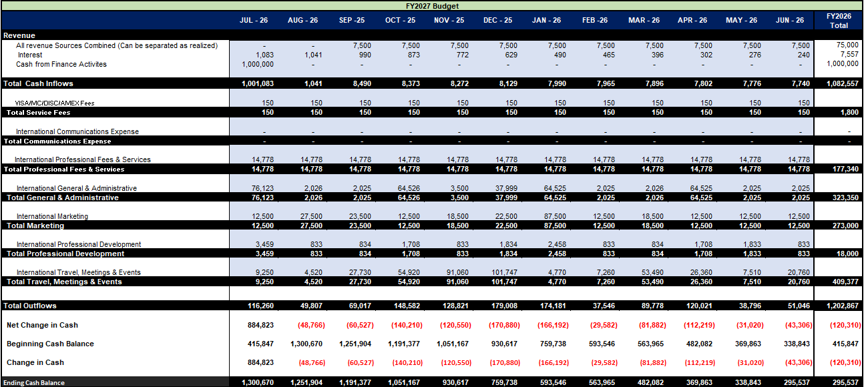
UCo FY2027 cash flow budget

Slide 53
Action item
Proposed Action Item:
The Finance Committee recommends to the Board of Directors that the FY2027 (2026 - 2027) Stellar MLS, IOBI, and UCO budgets be approved as presented with a $25 MLS Fee increase and a $25 unlicensed assistant Fee increase in FY2027.

Slide 54
Action item
Proposed Action Item:
The Finance Committee recommends to the Board of Directors that Stellar and IOBI may pull forward FY2027 Approved Capital projects and increase proposed staff at staff discretion.

Slide 55
Are there any outstanding issues or concerns we should address before adjourning?

Slide 56
Meeting adjourn
Next meeting to be held virtually on April 15, 2025.
Thank you!

