Slide 1
2027 Budget
Appendix

Slide 2
Appendix Table of Contents
December Consent Agenda Housing Metrics Pages 3-6
Labor Data Pages 7-14
Interest Rates and Inflation Pages 15-17
Housing Affordability Pages 18-20
GDP Pages 21-30

Slide 3
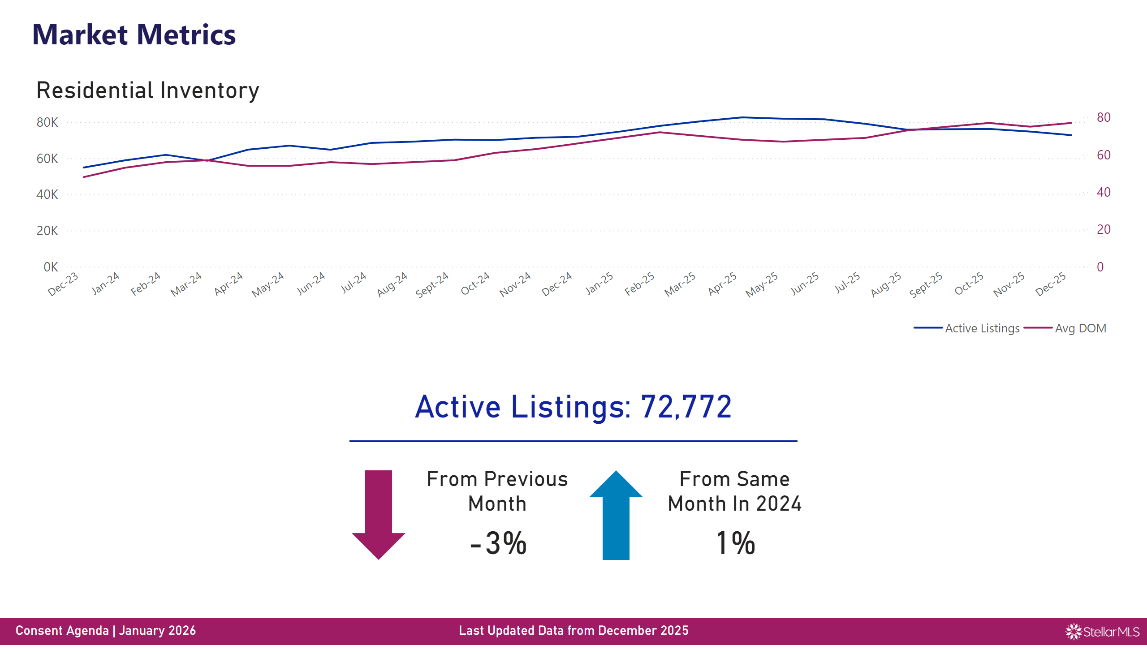
Market1
Notes:
textbox
No alt text provided
Residential Inventory
No alt text provided
Footer2
No alt text provided
Logo
No alt text provided
Background
No alt text provided
Footer1
No alt text provided
MoM Event Arrow
No alt text provided
From Previous Month
No alt text provided
YoY Events Arrow
No alt text provided
From Same Month In 2024
No alt text provided
Attendees Card
No alt text provided
shape
No alt text provided
textbox
No alt text provided

Slide 4
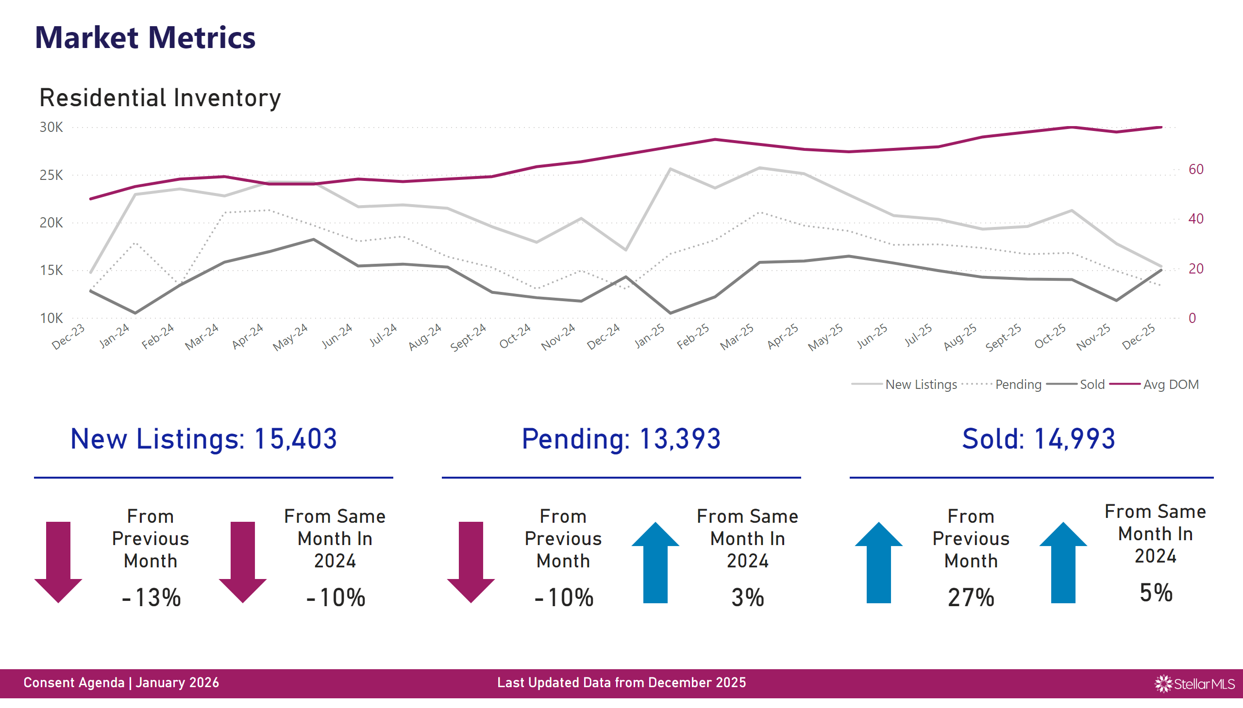
Market2
Notes:
textbox
No alt text provided
Residential Inventory
No alt text provided
MoM Event Arrow
No alt text provided
From Previous Month
No alt text provided
YoY Events Arrow
No alt text provided
From Same Month In 2024
No alt text provided
shape
No alt text provided
Attendees Card
No alt text provided
Attendees Card
No alt text provided
Attendees Card
No alt text provided
shape
No alt text provided
shape
No alt text provided
MoM Event Arrow
No alt text provided
From Previous Month
No alt text provided
YoY Events Arrow
No alt text provided
From Same Month In 2024
No alt text provided
MoM Event Arrow
No alt text provided
From Previous Month
No alt text provided
YoY Events Arrow
No alt text provided
From Same Month In 2024
No alt text provided
textbox
No alt text provided
Footer2
No alt text provided
Logo
No alt text provided
Background
No alt text provided
Footer1
No alt text provided

Slide 5
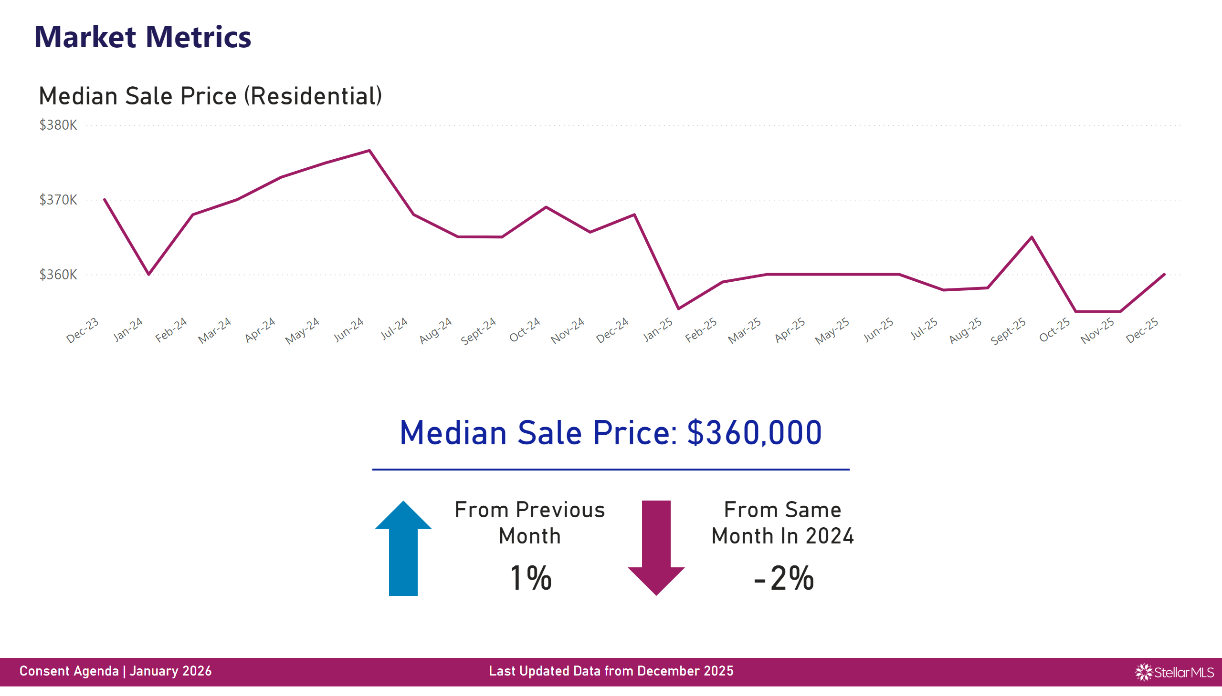
Market3
Notes:
textbox
No alt text provided
Footer2
No alt text provided
Logo
No alt text provided
Background
No alt text provided
Footer1
No alt text provided
MoM Event Arrow
No alt text provided
From Previous Month
No alt text provided
From Same Month In 2024
No alt text provided
Attendees Card
No alt text provided
shape
No alt text provided
Median Sale Price (Residential)
No alt text provided
YoY Events Arrow
No alt text provided

Slide 6
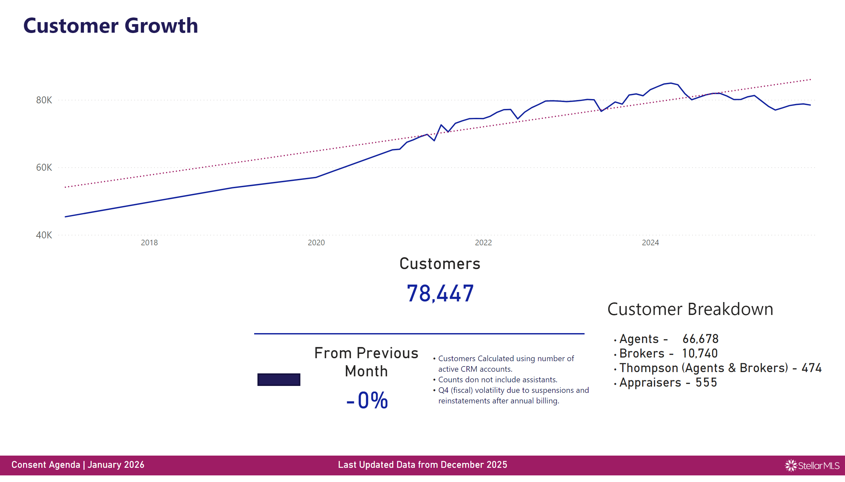
Customer Growth
Notes:
textbox
No alt text provided
y
No alt text provided
Footer2
No alt text provided
Logo
No alt text provided
Background
No alt text provided
Footer1
No alt text provided
MoM Event Arrow
No alt text provided
From Previous Month
No alt text provided
Customers
No alt text provided
shape
No alt text provided
textbox
No alt text provided
textbox
No alt text provided
textbox
No alt text provided

Slide 7
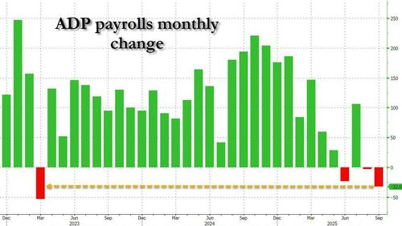
Employment Fluctuations

Slide 8
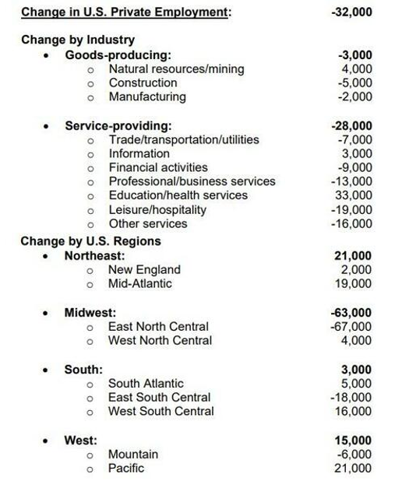
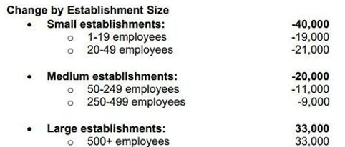
Employment Fluctuations

Slide 9
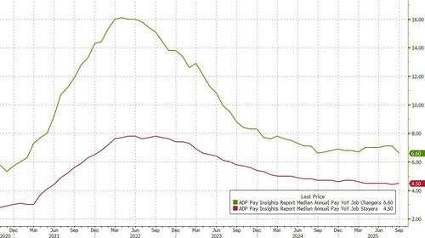
Wage growth +4.5%

Slide 10
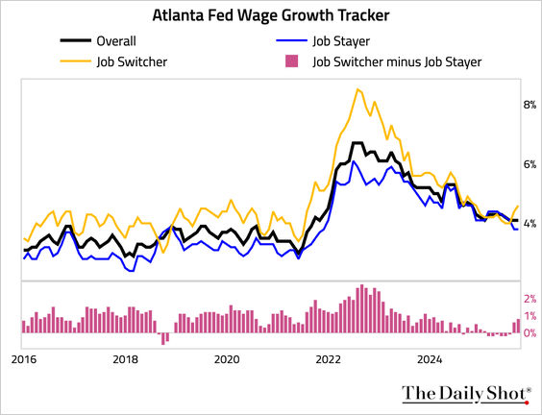
The Atlanta Fed’s Wage Growth Tracker was unchanged at 4.1%.
Wage growth for job switchers increased to 4.6%,
while wage growth for job stayers held at 3.8%.

Slide 11
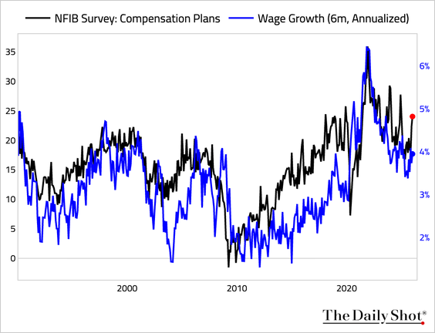
Wage plans (sharply higher):

Slide 12
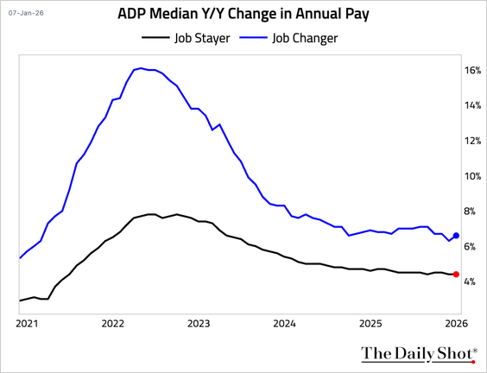
Wage growth picked up for job changers but held steady for job stayers.

Slide 13
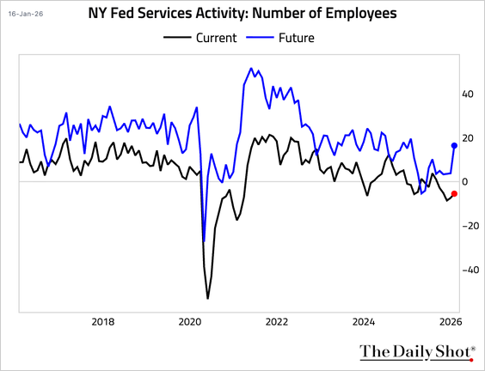
Employment contracted for a fifth consecutive month, but firms expect a significant rebound in hiring ahead.

Slide 14
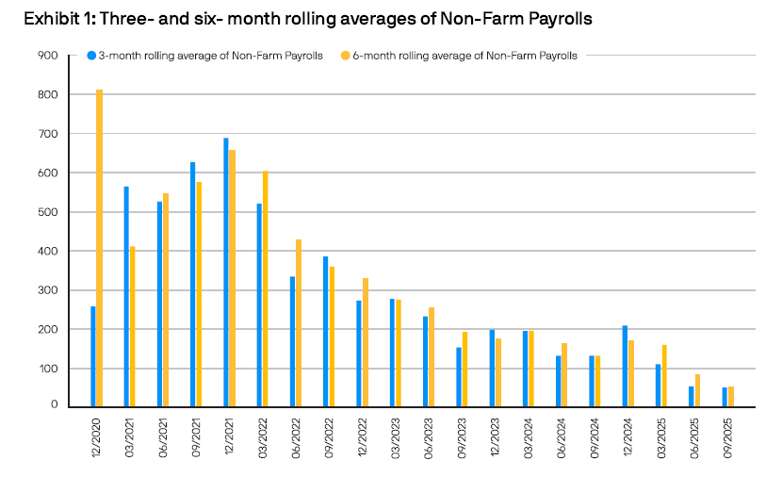

Slide 15
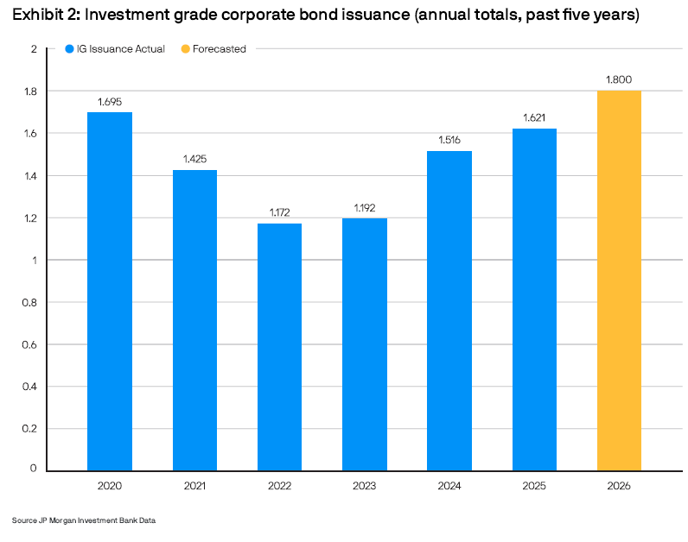

Slide 16
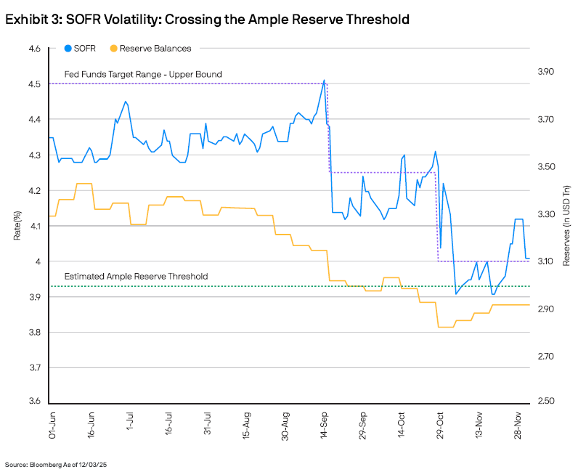

Slide 17
True Inflation
https://youtube.com/watch?v=KKCHYFg24s4&si=p8maMyD50pMM_h9a

Slide 18
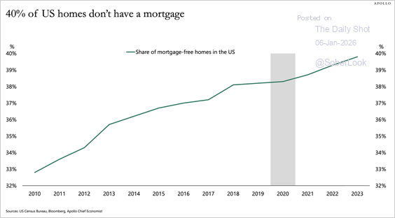
The share of US homes without a mortgage has grown from 33% in 2010 to 40%

Slide 19
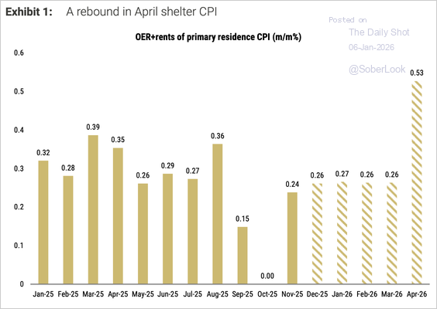
BLS clarified that the missed October data will cause a shelter CPI spike in April 2026. The chart below shows Morgan Stanley’s shelter inflation forecasts.
Source: Morgan Stanley Research

Slide 20
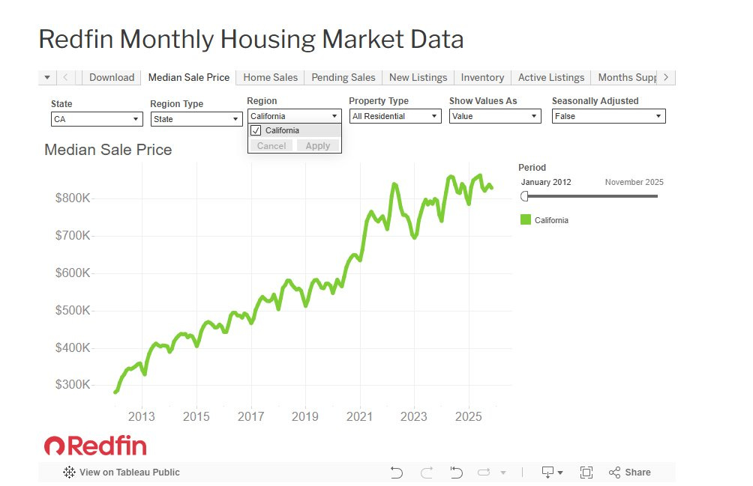

Slide 21
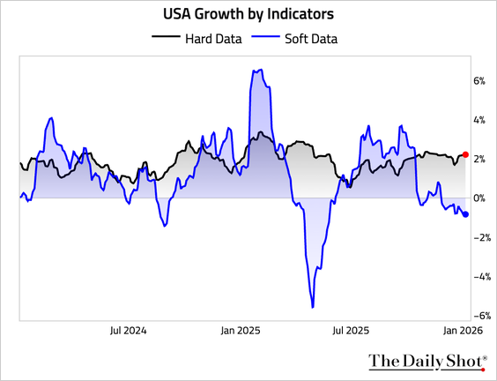
Our estimates suggest hard data continue to imply above-trend growth rates in the US, while soft data have been signaling weakness.

Slide 22
Source Material for Economic updates-
Housing Market Set for a 2026 Comeback, NAR Predicts- https://www.nar.realtor/magazine/real-estate-news/economy/housing-market-set-for-a-2026-comeback-nar-predicts
Apartment rents drop further, with vacancies at a record high- https://www.cnbc.com/2025/12/02/apartment-rents-vacancies-november.html?utm_source=substack&utm_medium=email
Mortgage rates move higher after the Fed rate cut, causing loan demand to drop-https://www.cnbc.com/2025/12/17/mortgage-rates-moved-higher-after-fed-rate-cut.html?usqp=mq331AQIUAKwASCAAgM=&amp_kit=1&recirc=taboolainternal

Slide 23
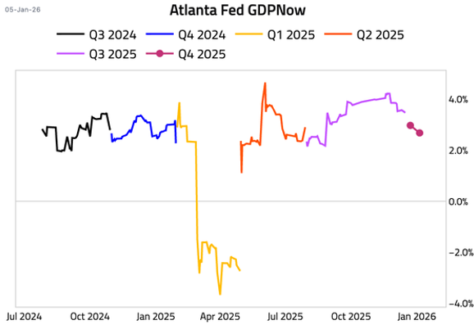
The Atlanta Fed’s GDPNow model is now tracking Q4 GDP at 2.7%, down from 3.0% on December 23

Slide 24
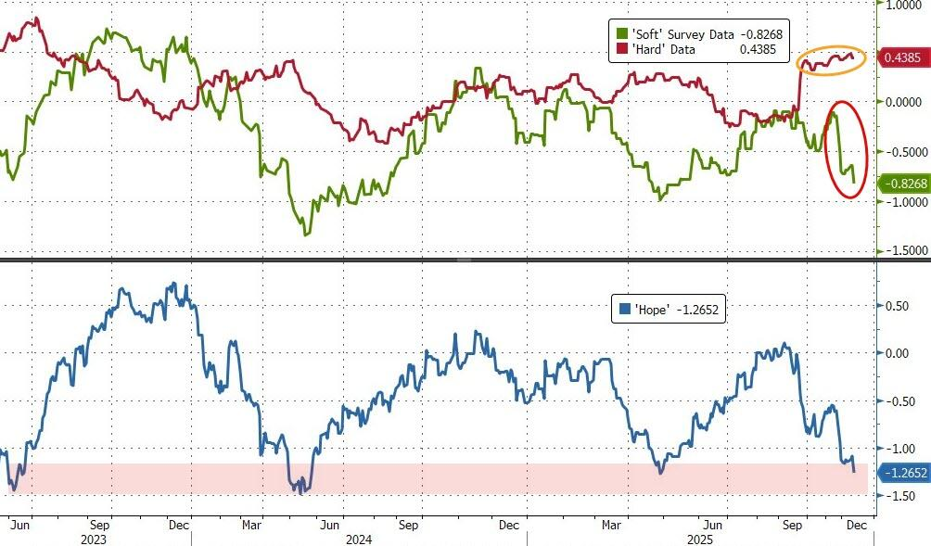

Slide 25
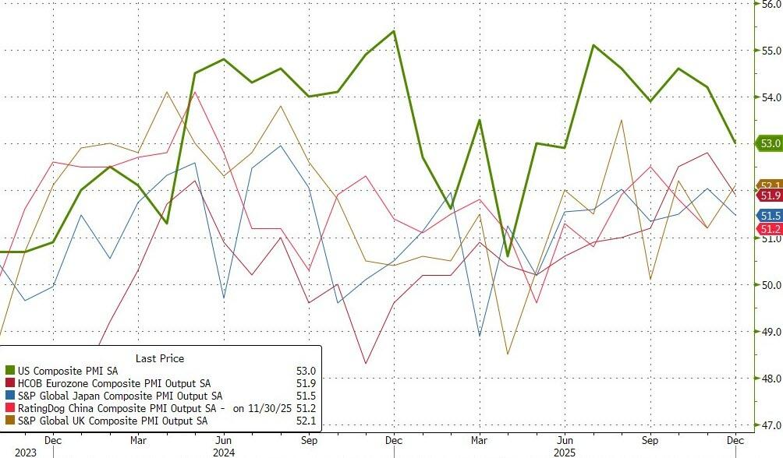
US PMIs remain well above the rest of the world

Slide 26
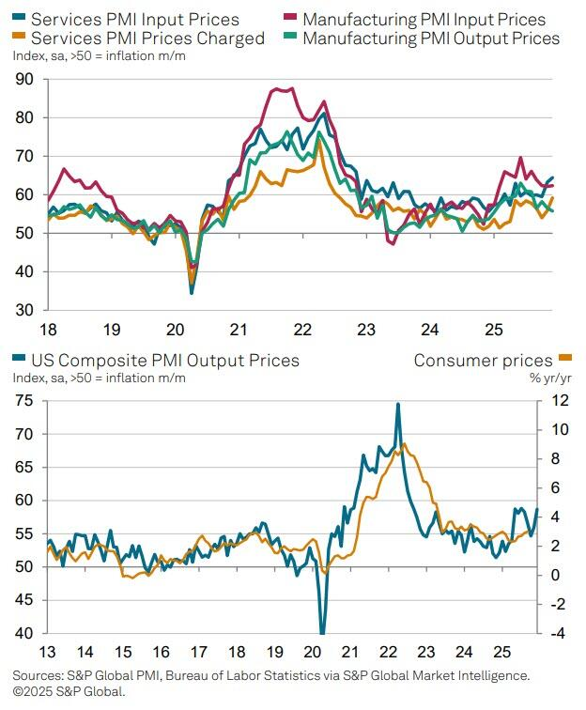
Higher prices are again being widely blamed on tariffs, according to Williamson, with an initial impact on manufacturing now increasingly spilling over to services to broaden the affordability problem.

Slide 27
Links to Article of Interest
South China News https://www.scmp.com/opinion/china-opinion/article/3290440/3-challenges-chinas-economic-growth-2025.
https://www.efginternational.com/us/insights/2024/germany_s_key_issues_and_the_coming_snap_elections.html
https://www.cnn.com/2024/10/28/business/volkswagen-factory-closures-layoffs/index.html
https://www.bls.gov/news.release/archives/empsit_09062024.pdf
https://www.statista.com/statistics/1121448/fed-balance-sheet-timeline/
https://www.floridajobs.org/docs/default-source/business-growth-and-partnerships/for-employers/posters-and-required-notices/2024-minim
https://www.statista.com/statistics/188105/annual-gdp-of-the-united-states-since-1990/

Slide 28
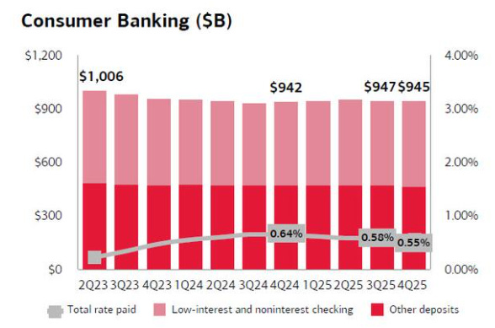
The consumer is holding up. People are still spending because they remain employed and checking account balances are stable. However, pandemic-era “excess savings” are spent, so people are selective with their spending.

Slide 29
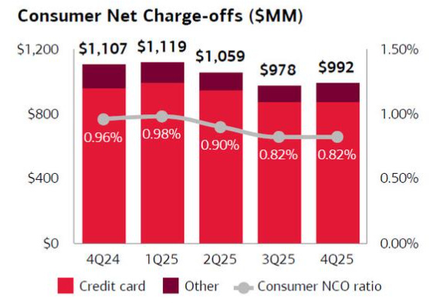
Credit card charge-offs are rising from very low levels but not at crisis levels yet.

Slide 30
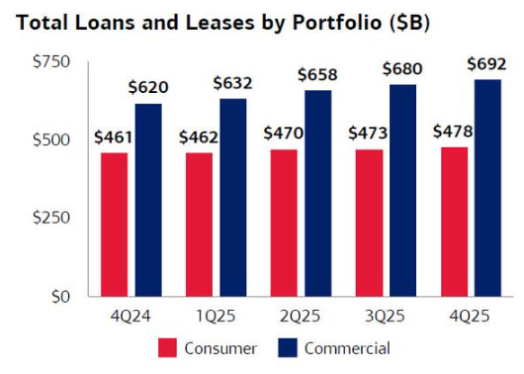
Higher interest rates from prior years are still weighing on mortgage activity and the housing markets. So, banks are not seeing a boom in new home lending. However, ongoing demand is still inching up, even if volumes are not strong. It will likely take some time for our housing thesis to play out.

