Slide 1

Finance committee
February Ytd Results & Investment Policy Update
April 14, 2026
10:00 AM to 12:00 PM
Zoom Meeting

Slide 2
stellar anti-trust reminder
Stellar MLS is a for profit corporation whose shareholders and members are engaged in similar businesses and Stellar MLS provides services to such shareholders and members. Whenever such persons engaged in similar businesses gather or when corporations provide services to such similar businesses, there is a risk of antitrust liability or of the appearance of anti-competitive activity. Stellar MLS has adopted strict policies to avoid any such liability or appearances. Any departure from these policies could result in severe civil and criminal penalties to you as individuals, to your company and to your association/board and Stellar MLS.

Slide 3
Agenda
Call to order |  | Don Lutz, Treasurer
Roll Call |  | Lynda Rable, Director of Finance
Approval of Prior Meeting Minutes
Financial Results:
FY2026 February Year-to-Date Financial Statements |  | Lynda Rable, Director of Finance
Invest Policy Update |  | Mark Schafer, Chief Financial Officer
Adjourn |  | Don Lutz, Treasurer

Slide 4
Stellar FY2026 Financials
February YTD Results

Slide 5
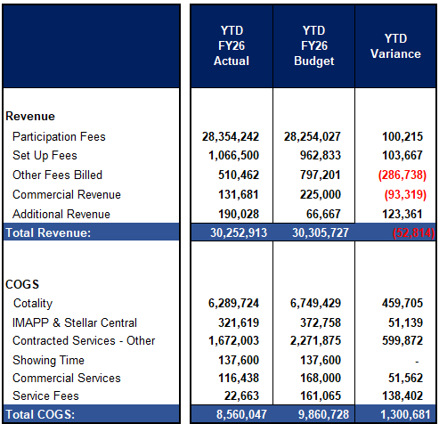
February YTD 2026 stellar financials actual vs. budget (1 of 2)
Participation & Set Up Fees: Better than planned as new & reinstated customers are exceeding planned volumes (Budget Volumes are lower than last year, but actuals are beating budget).
Other Fees: Below budget as our year-end estimate for 2025 was overstated for Reinstatement Fees. Will largely be offset by year-end.
Commercial Revenue: We discovered an error in how the base data was rolling up, which overstated commercial revenue. This has been corrected and will result in an unfavorable variance to the year-end budget, in line with our December YTD results.
Additional Revenue: Royalties for Skyslope and Rent Spree.
Cotality: Is favorable to the plan primarily due to rate savings and lower-than-planned customer volume.
IMAPP & Stellar Central: Is primarily timing-related and expected to be closer to budget by year-end.
Contracted Services: Favorable plan due to the delayed implementation of planned new products (New Product placeholder)
Commercial Services – Favorable to plan primarily due to fewer commercial customers than planned.
Service Fees: primarily timing-related and will come back to the budget by year-end.

Slide 6
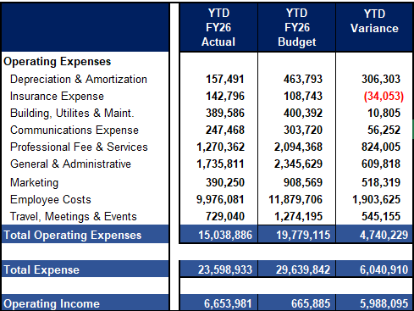
February YTD 2026 stellar financials actual vs. budget (2 of 2)
Employee Costs: Favorable to plan due to open reqs and all the associated benefit costs.
Professional Fees: Favorable to plan, driven by CRM & ERP enhancements that have not yet been placed in service due to project delays. The ERP project kicked off in Jan and has since gone live.
General & Administrative: Under plan due to the timing of Hardware/Software as well as Cyber Security spending.
Marketing: Marketing expenses are being incurred differently than originally planned.
Travel, Meeting, and Events Primarily Timing.
Insurance Expense: Increased rates for E&O. Auto insurance paid in full rather than amortized due to new prepaid threshold.

Slide 7
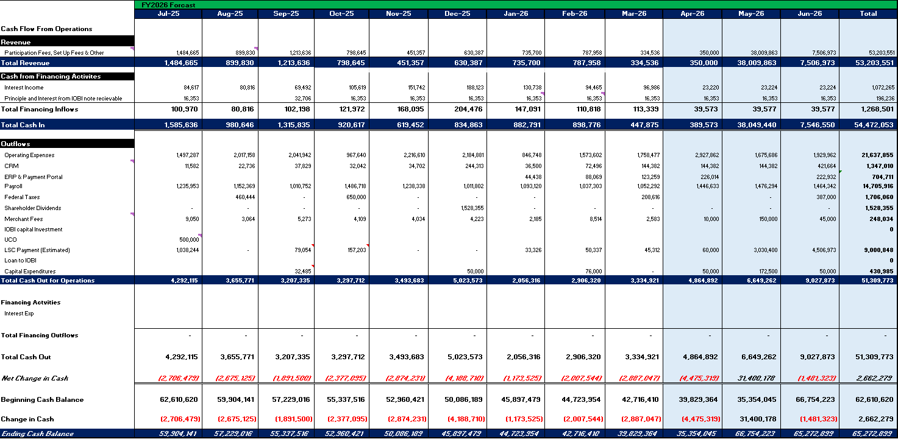
Stellar fy2026 cash flow

Slide 8
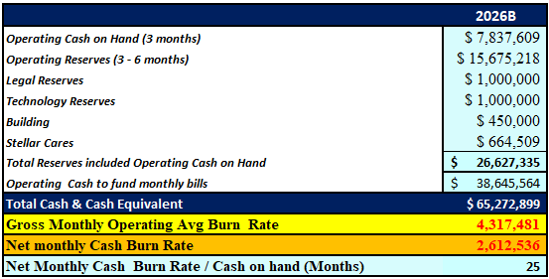
Stellar fy2026 Reserves
Reserves are forecast to be fully funded, with ~$38.6M in additional cash to fund monthly operations in FY2026.
Stellar Cares February YTD Reserves are $665,000 and fluctuate year to year as new fine revenue is added and charitable contributions are paid out.
Based on net cash monthly burn rate (monthly revenue – operating expenses) Stellar has ~25 months of cash on hand to meet operating costs.
Gross Monthly Operating burn - ~$4.3M
Net Monthly Cash burn - ~$2.6M

Slide 9
iobi FY2026 financials february YTD Results

Slide 10
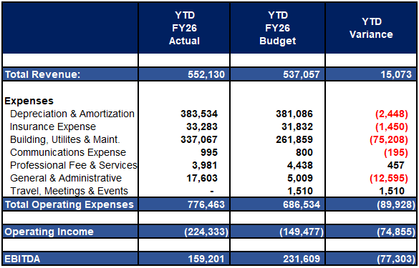
February YTD 2026 IOBI financials actual vs. budget
Building, Utilities & Maint. Unfavorable due to the backflow meter $15K replacement, Fire Marshal citation compliance costs, and irrigation sprinkler repairs.
Insurance: Liability coverage rates increased after budget was completed.
General & Administrative: For IOBI boardroom refresh maintenance contract.
EBITDA: Is under budget primarily due to unplanned expenses for Building, Utilities & Maintenance.

Slide 11
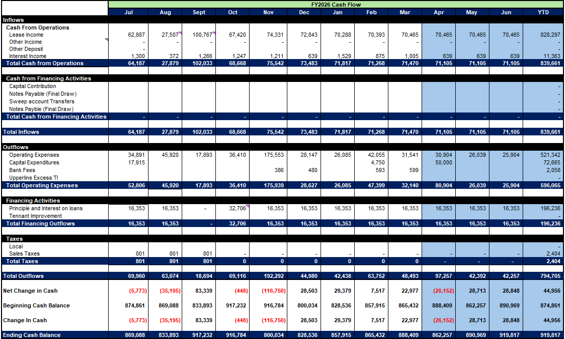
Iobi fy2026 Forecast cash flow

Slide 12
UCO FY2026 Financials
February YTD Results

Slide 13
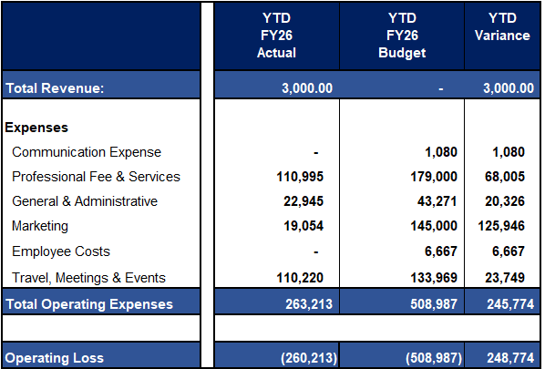
February YTD 2026 UCO financials actual vs. budget
Total Operating Expenses: below budget as the UCO team is judicially spending their resources across the board.
Employee Cost: Due to the slow ramp-up in revenue realization, Stellar will absorb salary costs for the foreseeable future.

Slide 14
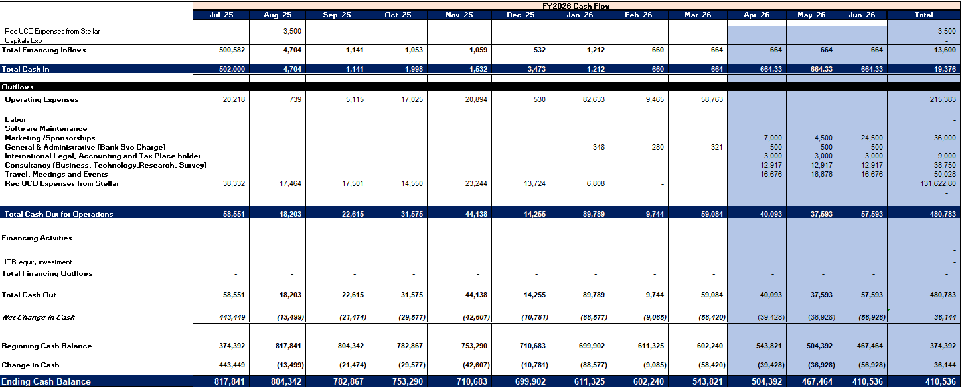
UCO fy2026 Forecast cash flow

Slide 15
Action item
Proposed Action Item:
The Finance Committee recommends to the Board of Directors that the Stellar, IOBI, and UCO February YTD results be filed for a consolidated audit.

Slide 16
Investment Policy Update

Slide 17
Investment Policy Update - Cover / Identification
Finance Committee draft | Slide 1 of 4
Original policy
Removed language / replacement
Final proposed policy
PNC Institutional Asset Management
Investment Policy Statement
Stellar LOC Collateral Account
Prepared by Adam J. Varga, CFA, CIMA
Vice President, Senior Investment Advisor
Date shown on cover: November 7, 2024
PNC Institutional Asset Management
Proposed Investment Policy Statement
Stellar LOC Collateral Account
JPMorgan 100% U.S. Treasury Securities Money Market Fund - I Shares (JTSXX)
Best-practice intent:
Replace the former PNC LOC investment account policy with a treasury-only cash management policy aligned to the official JPMorgan fund objective and strategy.
Core objective:
Provide current income while maintaining liquidity and stability of principal.
The Finance Committee recommends the Board of Directors to approve the change in investment policy to JPMorgan 100% U.S. Treasury Securities Money Market Fund – I Shares (JTSXX)
Investment Policy Statement
Proposed Investment Policy Statement
Stellar Investment Account
Stellar LOC Collateral Account
Prepared by Adam J. Varga, CFA, CIMA
Vice President, Senior Investment Advisor
JPMorgan 100% U.S. Treasury Securities Money Market Fund - I Shares (JTSXX)
Date shown on cover: November 7, 2024
Best-practice intent:
Replace the former PNC LOC investment account policy with a treasury-only cash management policy aligned to the official JPMorgan fund objective and strategy.
PNC-specific cover branding and advisor identification
Core objective:
Provide current income while maintaining liquidity and stability of principal.
Draft prepared from the uploaded PNC investment policy and official JPMorgan fund materials for Finance Committee discussion.
Notes:
[Sources]
- Uploaded original policy PDF: LOC IPS 12.3.2024.pdf
- Official JPMorgan fund page: https://am.jpmorgan.com/us/en/asset-management/liq/products/jpmorgan-100-us-treasury-securities-money-market-fund-institutional-4812a2835
- Official JPMorgan fact sheet: https://am.jpmorgan.com/content/dam/jpm-am-aem/americas/us/en/literature/fact-sheet/money-market/FS-100USTS-CAP.PDF
- SEC prospectus filing: https://www.sec.gov/Archives/edgar/data/1217286/000119312524164766/d823943d497k.htm

Slide 18
Sections I-III - Purpose, Investor Profile, Restrictions
Finance Committee draft | Slide 2 of 4
Original policy
Removed language / replacement
Final proposed policy
I. Purpose
The purposes of this Investment Policy Statement (IPS) are (i) to document our understanding of the investment goals and guidelines for the portfolio, including the investment objective, risk tolerance, investment restrictions and asset allocation ranges, and (ii) to establish a basis upon which to evaluate the attainment of portfolio objectives.
II. Investor Profile
A. Investment Time Horizon: The period of time during which the assets will be invested is expected to be 5 Years +.
B. Portfolio Risk Tolerance: Investments may fluctuate and suffer occasional losses, so that overall returns will keep pace with inflation.
C. Investment Objectives: The overall investment objective for this portfolio is Income with Moderate Growth.
III. Restrictions and Limitations
Additional Comments: As it pertains to the line of credit margin needs, optimize portfolio holdings in conjunction with PNC's margin limits for a given asset class and security type. Preference given to diversified mutual funds and ETFs.
Excluded Security Type / Asset Type: For equities: No individual corporate equities, preferred and convertible stocks, or MLP's. For bonds: No individual CMO's, U.S. Savings Bonds, or structured notes.
5 Years +
I. Purpose
This IPS documents the investment objectives and operating guidelines for cash and collateral reserves held in the Stellar Investment Account.
II. Investment Objective and Strategy
Objective: Provide current income while maintaining liquidity and stability of principal.
Permissible investment: JPMorgan 100% U.S. Treasury Securities Money Market Fund - I Shares (JTSXX).
Official fund strategy: invests solely in debt securities of the U.S. Treasury, including Treasury bills, bonds and notes.
The fund is managed to meet Rule 2a-7 under the Investment Company Act of 1940.
The fund is designed for temporary or medium-term cash investments, seasonal operating cash, automated cash sweeps and liquidity components of investment portfolios.
III. Risk / Return Profile and Restrictions
Primary priorities are preservation of capital, daily liquidity and operational cash availability. Competitive yield is secondary to liquidity and principal stability. No equity, credit, alternative asset, structured product, or non-Treasury exposure is permitted in this account.
Income with Moderate Growth
Objective: Provide current income while maintaining liquidity and stability of principal.
Investments may fluctuate and suffer occasional losses,
so that overall returns will keep pace with inflation.
Primary priorities are preservation of capital, daily liquidity and operational cash availability. Competitive yield is secondary to liquidity and principal stability.
optimize portfolio holdings in conjunction with PNC's margin limits
Preference given to diversified mutual funds and ETFs.
Permissible investment: JPMorgan 100% U.S. Treasury Securities Money Market Fund - I Shares (JTSXX).
No individual corporate equities, preferred and convertible stocks, or MLP's.
No individual CMO's, U.S. Savings Bonds, or structured notes.
No equity, credit, alternative asset, structured product, or non-Treasury exposure is permitted in this account.
broad portfolio guidelines and asset allocation ranges
Official fund strategy: invests solely in debt securities of the U.S. Treasury, including Treasury bills, bonds and notes.
The fund is managed to meet Rule 2a-7 under the Investment Company Act of 1940.
Draft prepared from the uploaded PNC investment policy and official JPMorgan fund materials for Finance Committee discussion.
Notes:
[Sources]
- Uploaded original policy PDF: LOC IPS 12.3.2024.pdf
- Official JPMorgan fund page: https://am.jpmorgan.com/us/en/asset-management/liq/products/jpmorgan-100-us-treasury-securities-money-market-fund-institutional-4812a2835
- Official JPMorgan fact sheet: https://am.jpmorgan.com/content/dam/jpm-am-aem/americas/us/en/literature/fact-sheet/money-market/FS-100USTS-CAP.PDF
- SEC prospectus filing: https://www.sec.gov/Archives/edgar/data/1217286/000119312524164766/d823943d497k.htm

Slide 19
Sections IV-VIII - Allocation, Authority, Performance
Finance Committee draft | Slide 3 of 4
Original policy
Removed language / replacement
Final proposed policy
IV. Strategic Asset Allocation
Equity 50.00% (min 40.0 / max 60.0)
Fixed Income 48.50% (min 38.5 / max 58.5)
Cash 1.50% (min 0.0 / max 11.5)
Alternative Assets 0.00% (min 0.0 / max 10.0)
V. Strategic Considerations
The allocation represents a customized investment framework with baseline allocation percentages for each major asset class. The assets of this portfolio shall be diversified among various classes of investments, unless PNC is directed otherwise. PNC may make tactical changes from time to time.
VI. Investment Authority
STELLAR LOC 20-50-002-XXX3665 - Full / Sole Discretion
VII. Performance Measurement
Benchmarks used: Barclays U.S. Aggregate Bond, ICE BofA U.S. Treasuries - Bills (3M), Russell 3000, and MSCI ACWI ex USA All Cap Index.
VIII. Additional Comments
No Additional Comments.
Equity 50.00%
IV. Strategic Allocation
Target allocation: 100% JPMorgan 100% U.S. Treasury Securities Money Market Fund - I Shares (JTSXX).
Minimum / maximum target to fund: 100% / 100%, except for temporary settlement cash.
V. Strategic Considerations
This is a treasury-only liquidity vehicle, not a diversified growth portfolio. No tactical asset allocation among equities, broad fixed income, cash and alternatives is contemplated under this IPS.
VI. Investment Authority
The Finance Committee and authorized management shall oversee the account in accordance with approved banking and custody authorities.
VII. Performance Measurement
Success will be evaluated by maintaining liquidity, preserving principal and generating current income consistent with the fund strategy. Reference measures may include the fund's 7-day SEC yield, daily liquidity and weekly liquidity.
VIII. Additional Comments
This account is intended to serve as a cash management and collateral reserve vehicle.
Fixed Income 48.50%
Cash 1.50%
Alternative Assets 0.00%
Target allocation: 100% JPMorgan 100% U.S. Treasury Securities Money Market Fund - I Shares (JTSXX).
Minimum / maximum target to fund: 100% / 100%, except for temporary settlement cash.
customized investment framework with baseline allocation percentages
diversified among various classes of investments
PNC may make tactical changes from time to time.
This is a treasury-only liquidity vehicle, not a diversified growth portfolio. No tactical asset allocation among equities, broad fixed income, cash and alternatives is contemplated under this IPS.
STELLAR LOC 20-50-002-XXX3665 - Full / Sole Discretion
The Finance Committee and authorized management shall oversee the account in accordance with approved banking and custody authorities.
Barclays U.S. Aggregate Bond
ICE BofA U.S. Treasuries - Bills (3M)
Russell 3000
MSCI ACWI ex USA All Cap Index
Success will be evaluated by maintaining liquidity, preserving principal and generating current income consistent with the fund strategy. Reference measures may include the fund's 7-day SEC yield, daily liquidity and weekly liquidity.
This account is intended to serve as a cash management and collateral reserve vehicle.
Draft prepared from the uploaded PNC investment policy and official JPMorgan fund materials for Finance Committee discussion.
Notes:
[Sources]
- Uploaded original policy PDF: LOC IPS 12.3.2024.pdf
- Official JPMorgan fund page: https://am.jpmorgan.com/us/en/asset-management/liq/products/jpmorgan-100-us-treasury-securities-money-market-fund-institutional-4812a2835
- Official JPMorgan fact sheet: https://am.jpmorgan.com/content/dam/jpm-am-aem/americas/us/en/literature/fact-sheet/money-market/FS-100USTS-CAP.PDF
- SEC prospectus filing: https://www.sec.gov/Archives/edgar/data/1217286/000119312524164766/d823943d497k.htm

Slide 20
Section IX - Governance, Approval, and Reference Disclosure
Finance Committee draft | Slide 4 of 4
Original policy
Removed language / replacement
Final proposed policy
IX. Signator's Role
As financial circumstances, goals, investment objectives and preferences change, it is important that you communicate those changes to us so that appropriate adjustments can be made in the portfolio.
The IPS applies to all of the accounts that constitute the Portfolio in the aggregate. PNC may manage each account to its own investment objective as long as all accounts in the aggregate comply with this IPS.
Each of PNC and the Signator is signing this IPS in the capacity defined by the governing instrument for each account listed in this IPS.
Approval page includes signature blocks for My Florida Regional MLS and PNC Bank, National Association, followed by PNC legal / marketing disclosures.
communicate those changes to us so that appropriate adjustments can be made in the portfolio.
IX. Governance and Review
As financial circumstances, liquidity needs and operating requirements change, the Finance Committee should review this IPS and authorize revisions when appropriate.
This IPS applies to investment assets held in the designated investment account.
Administrative, custodial and banking documents remain controlling for account operations, but investment activity should remain consistent with this IPS.
Approval
Approved by: Finance Committee / authorized officers
Effective date: ____________________
Reference fund disclosure
The fund seeks to preserve a $1.00 share value but cannot guarantee it. It is not a bank account, is not FDIC insured, and is not guaranteed by any government agency.
As financial circumstances, liquidity needs and operating requirements change, the Finance Committee should review this IPS and authorize revisions when appropriate.
The IPS applies to all of the accounts that constitute the Portfolio in the aggregate.
PNC may manage each account to its own investment objective as long as all accounts in the aggregate comply with this IPS.
This IPS applies to investment assets held in the designated investment account.
Draft prepared from the uploaded PNC investment policy and official JPMorgan fund materials for Finance Committee discussion.
Notes:
[Sources]
- Uploaded original policy PDF: LOC IPS 12.3.2024.pdf
- Official JPMorgan fund page: https://am.jpmorgan.com/us/en/asset-management/liq/products/jpmorgan-100-us-treasury-securities-money-market-fund-institutional-4812a2835
- Official JPMorgan fact sheet: https://am.jpmorgan.com/content/dam/jpm-am-aem/americas/us/en/literature/fact-sheet/money-market/FS-100USTS-CAP.PDF
- SEC prospectus filing: https://www.sec.gov/Archives/edgar/data/1217286/000119312524164766/d823943d497k.htm

Slide 21
Action item
Proposed Action Item:
The Finance Committee recommends to the Board of Directors to approve the new investment policy for Stellar MLS.

Slide 22
Are there any outstanding issues or concerns we should address before adjourning?

Slide 23
Meeting adjourned
Thank you!

